Slide 1
SQL Day 7 Part 1

Slide 2


Slide 3


Slide 4


Slide 5


Slide 6
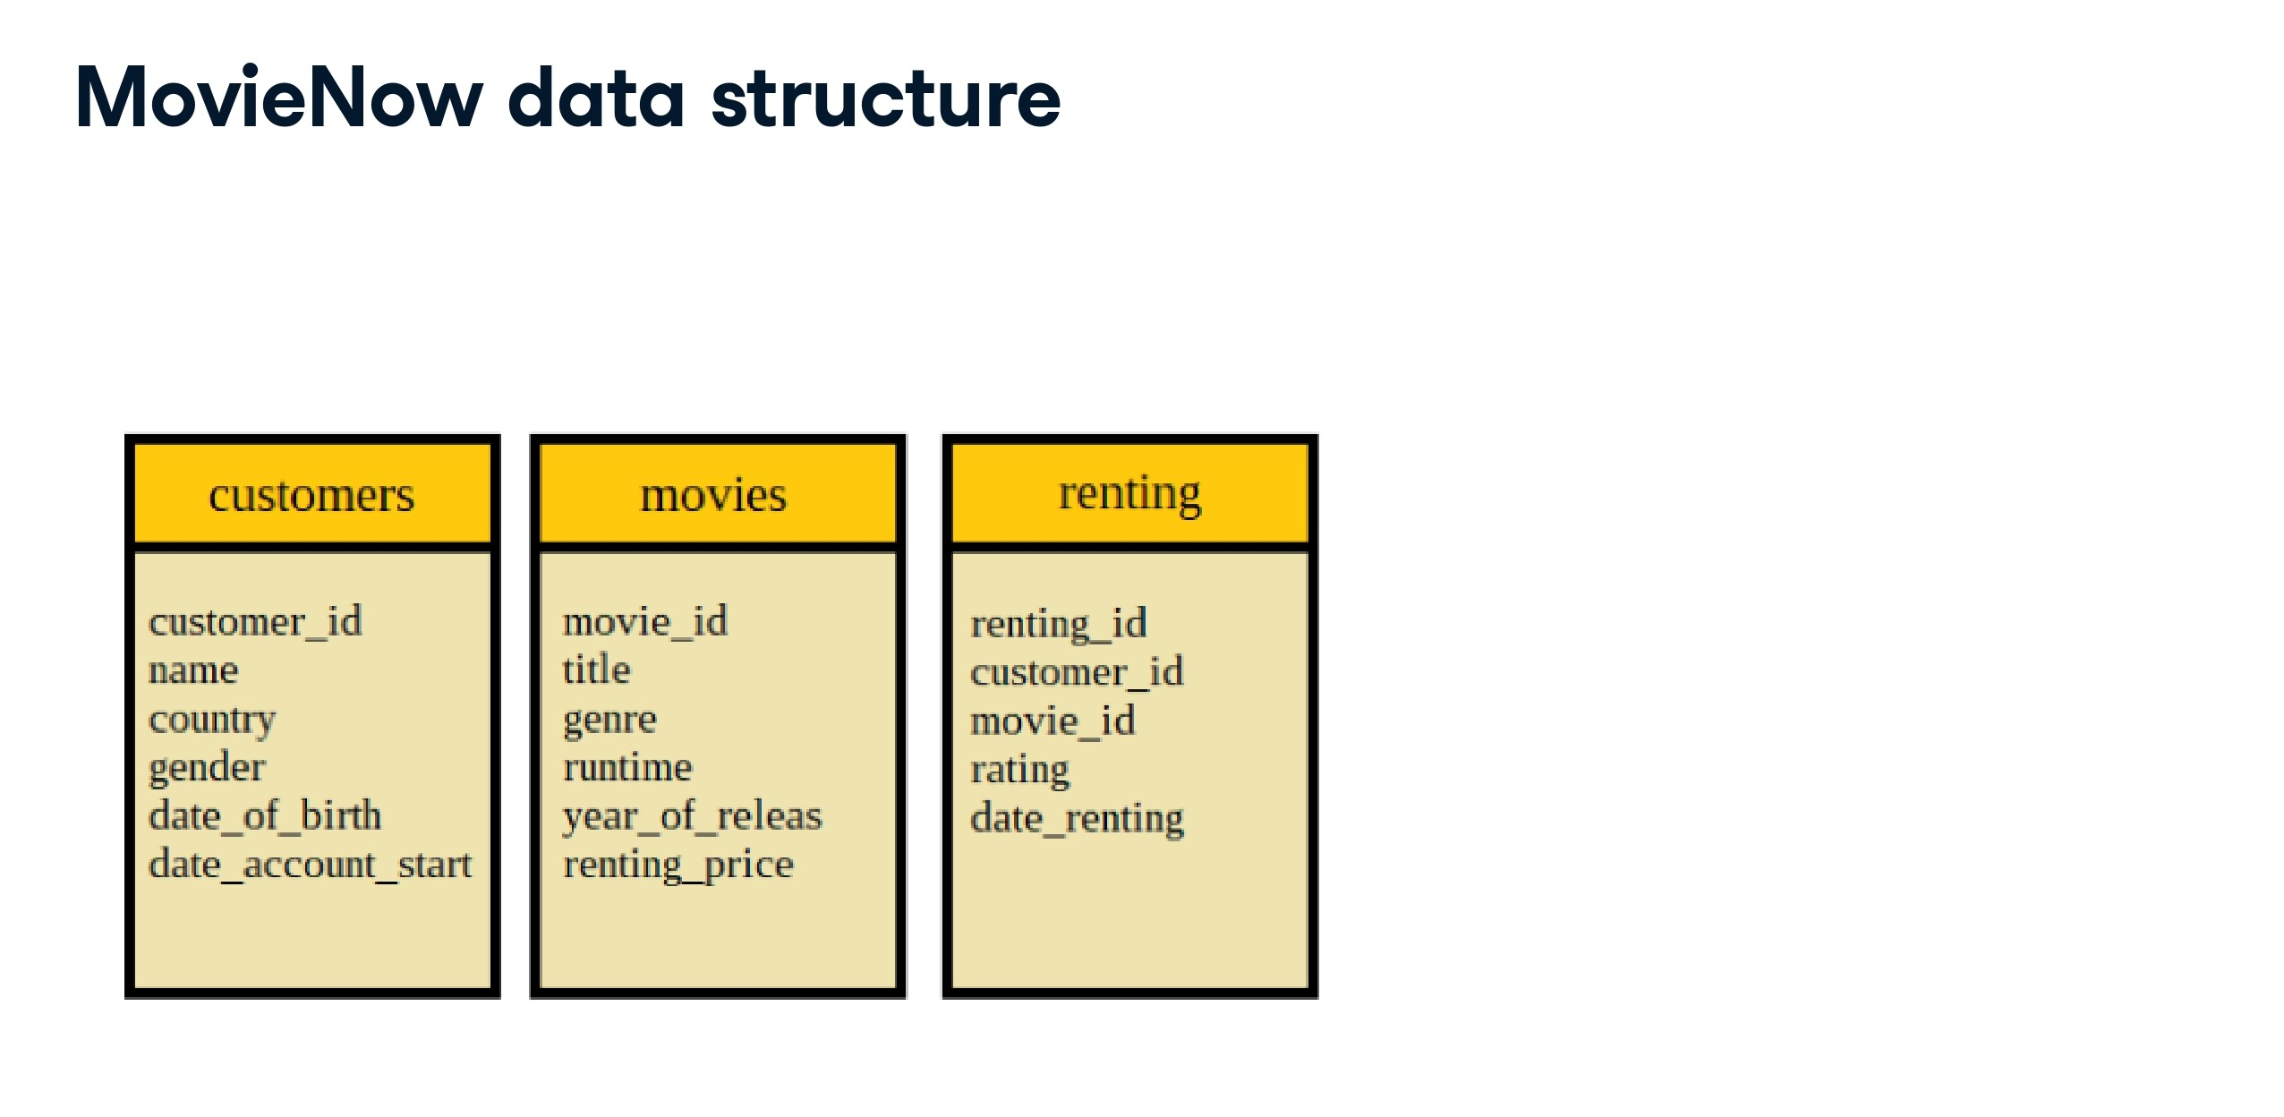

Slide 7
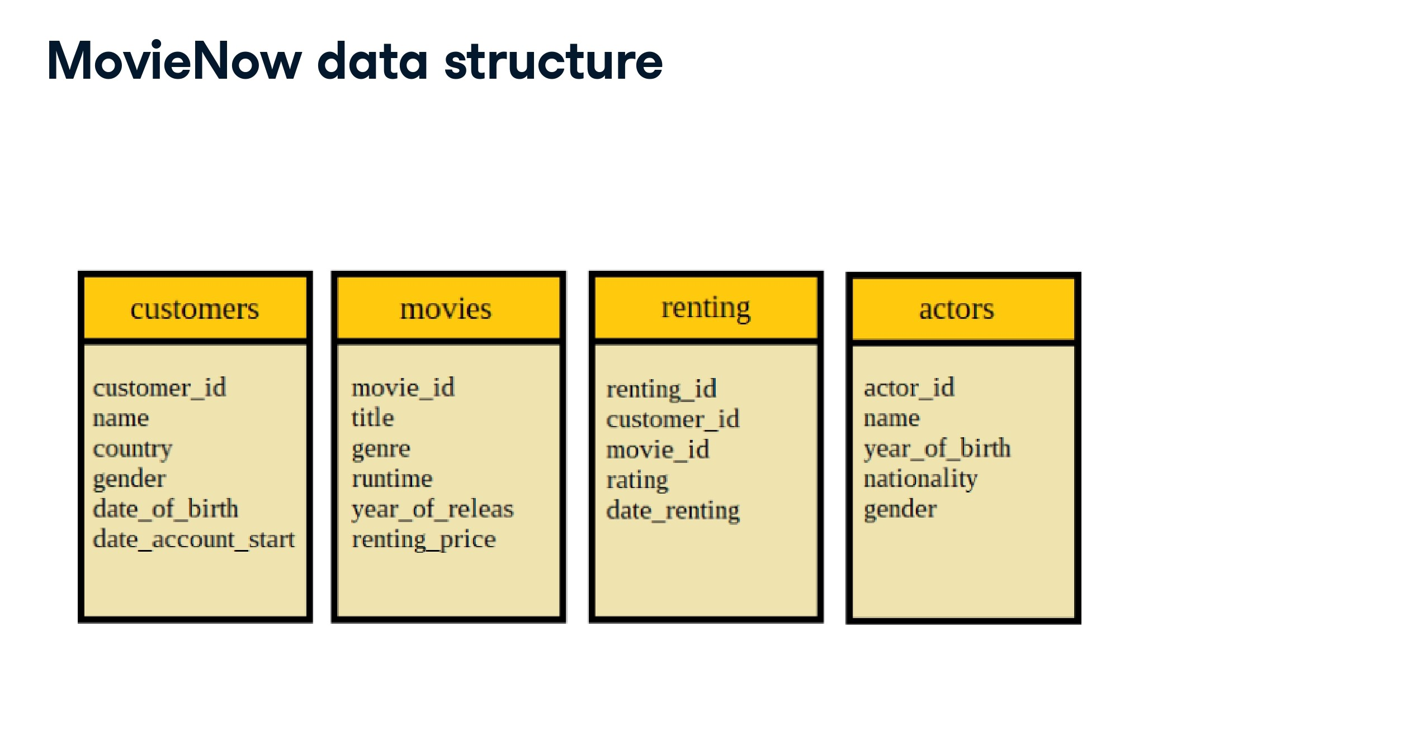

Slide 8
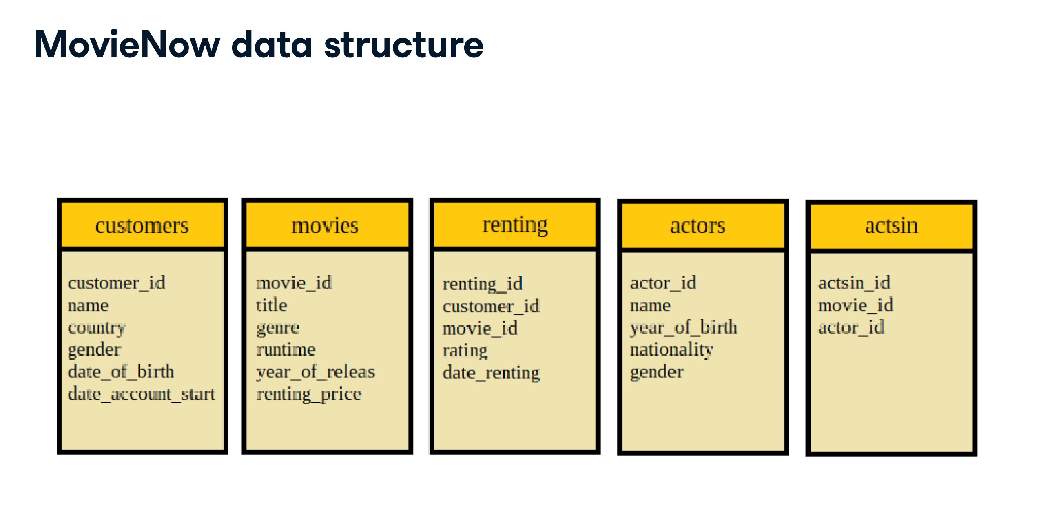

Slide 9
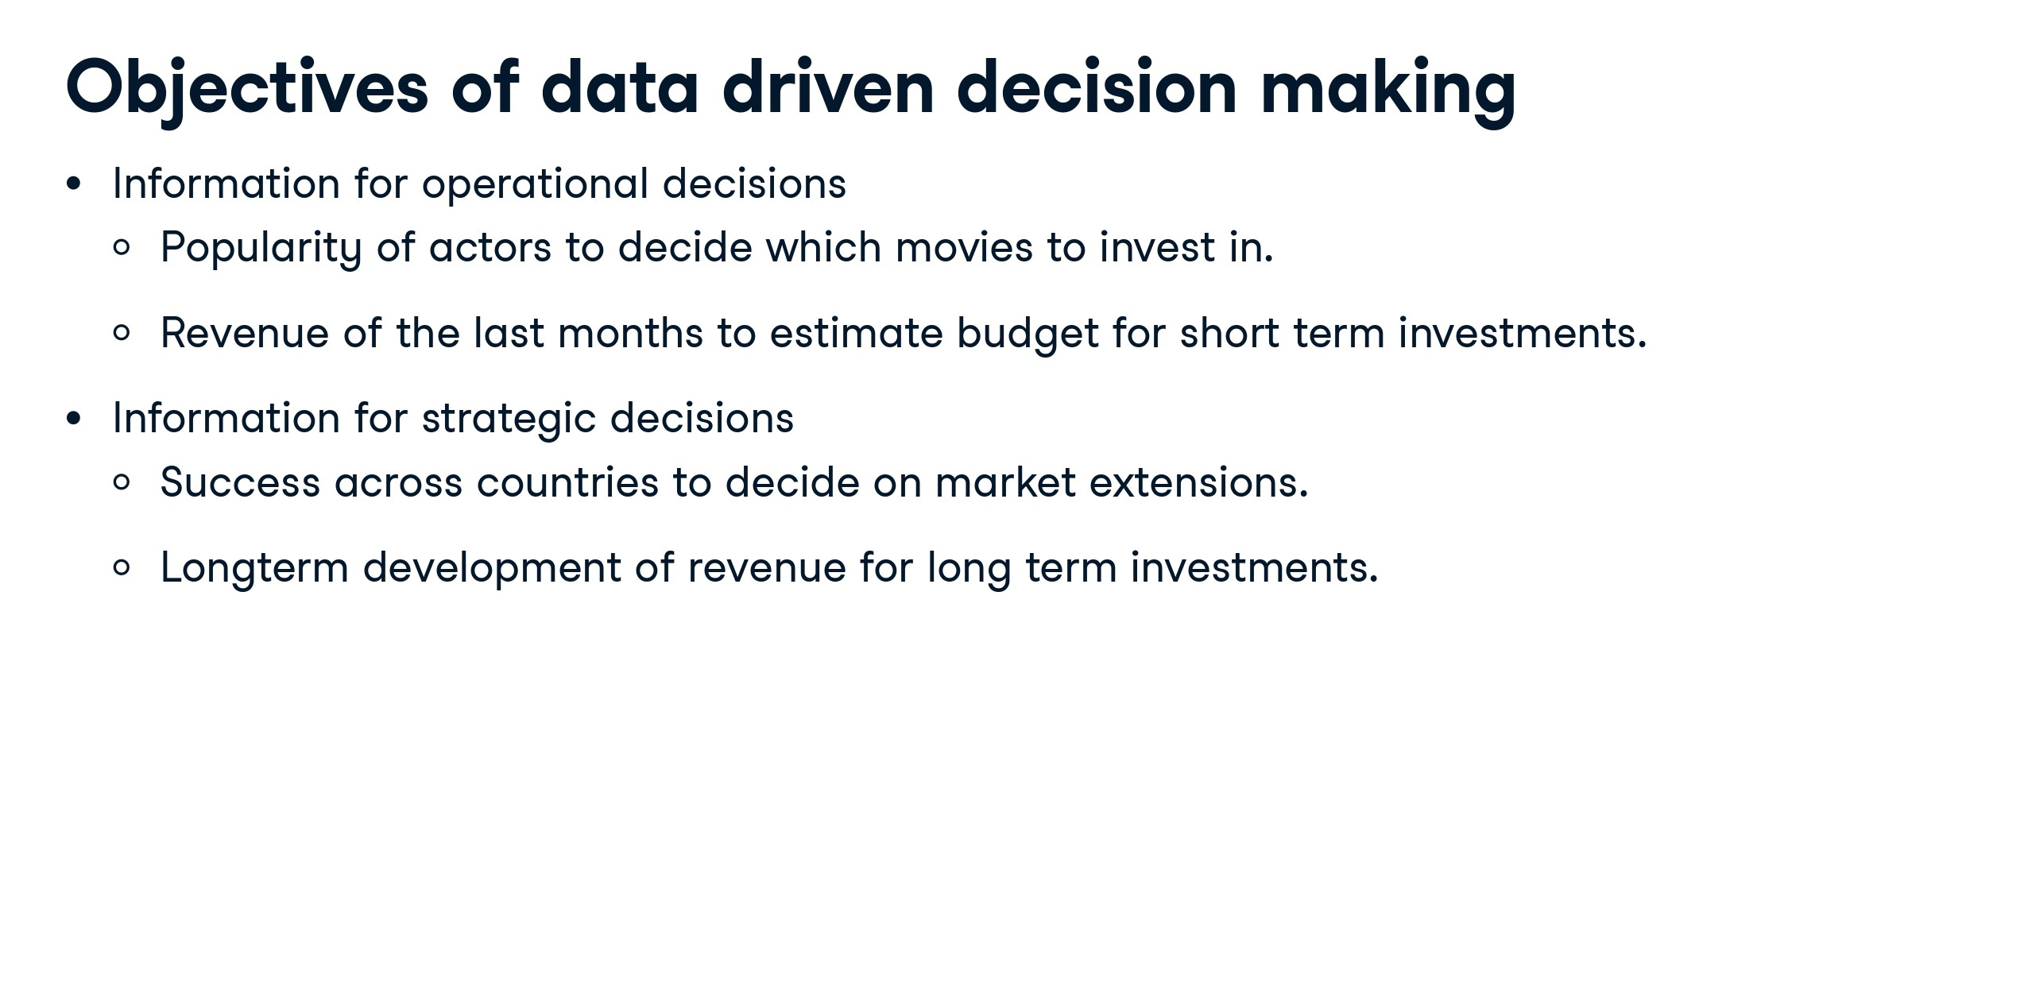

Slide 10
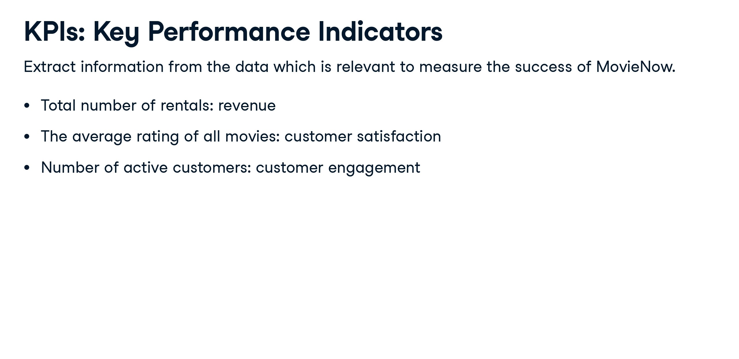

Slide 11


Slide 12


Slide 13
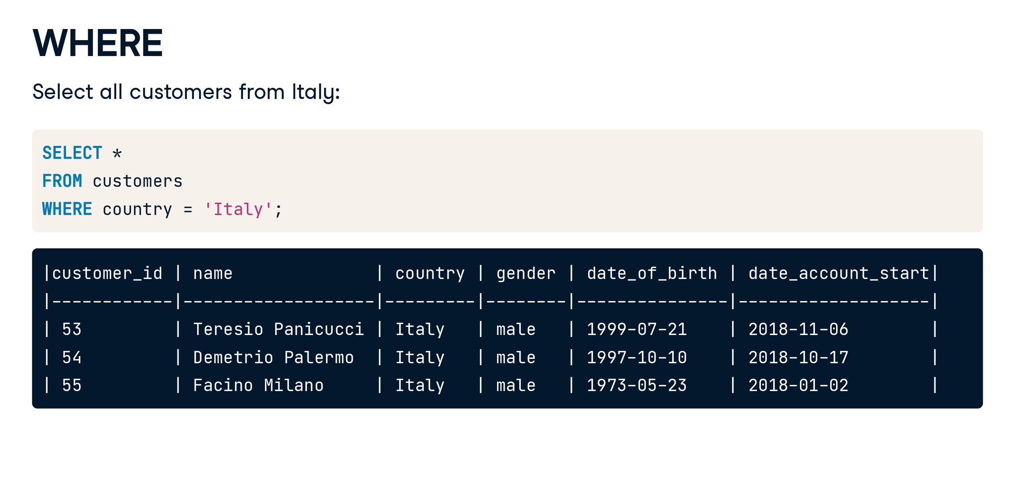

Slide 14
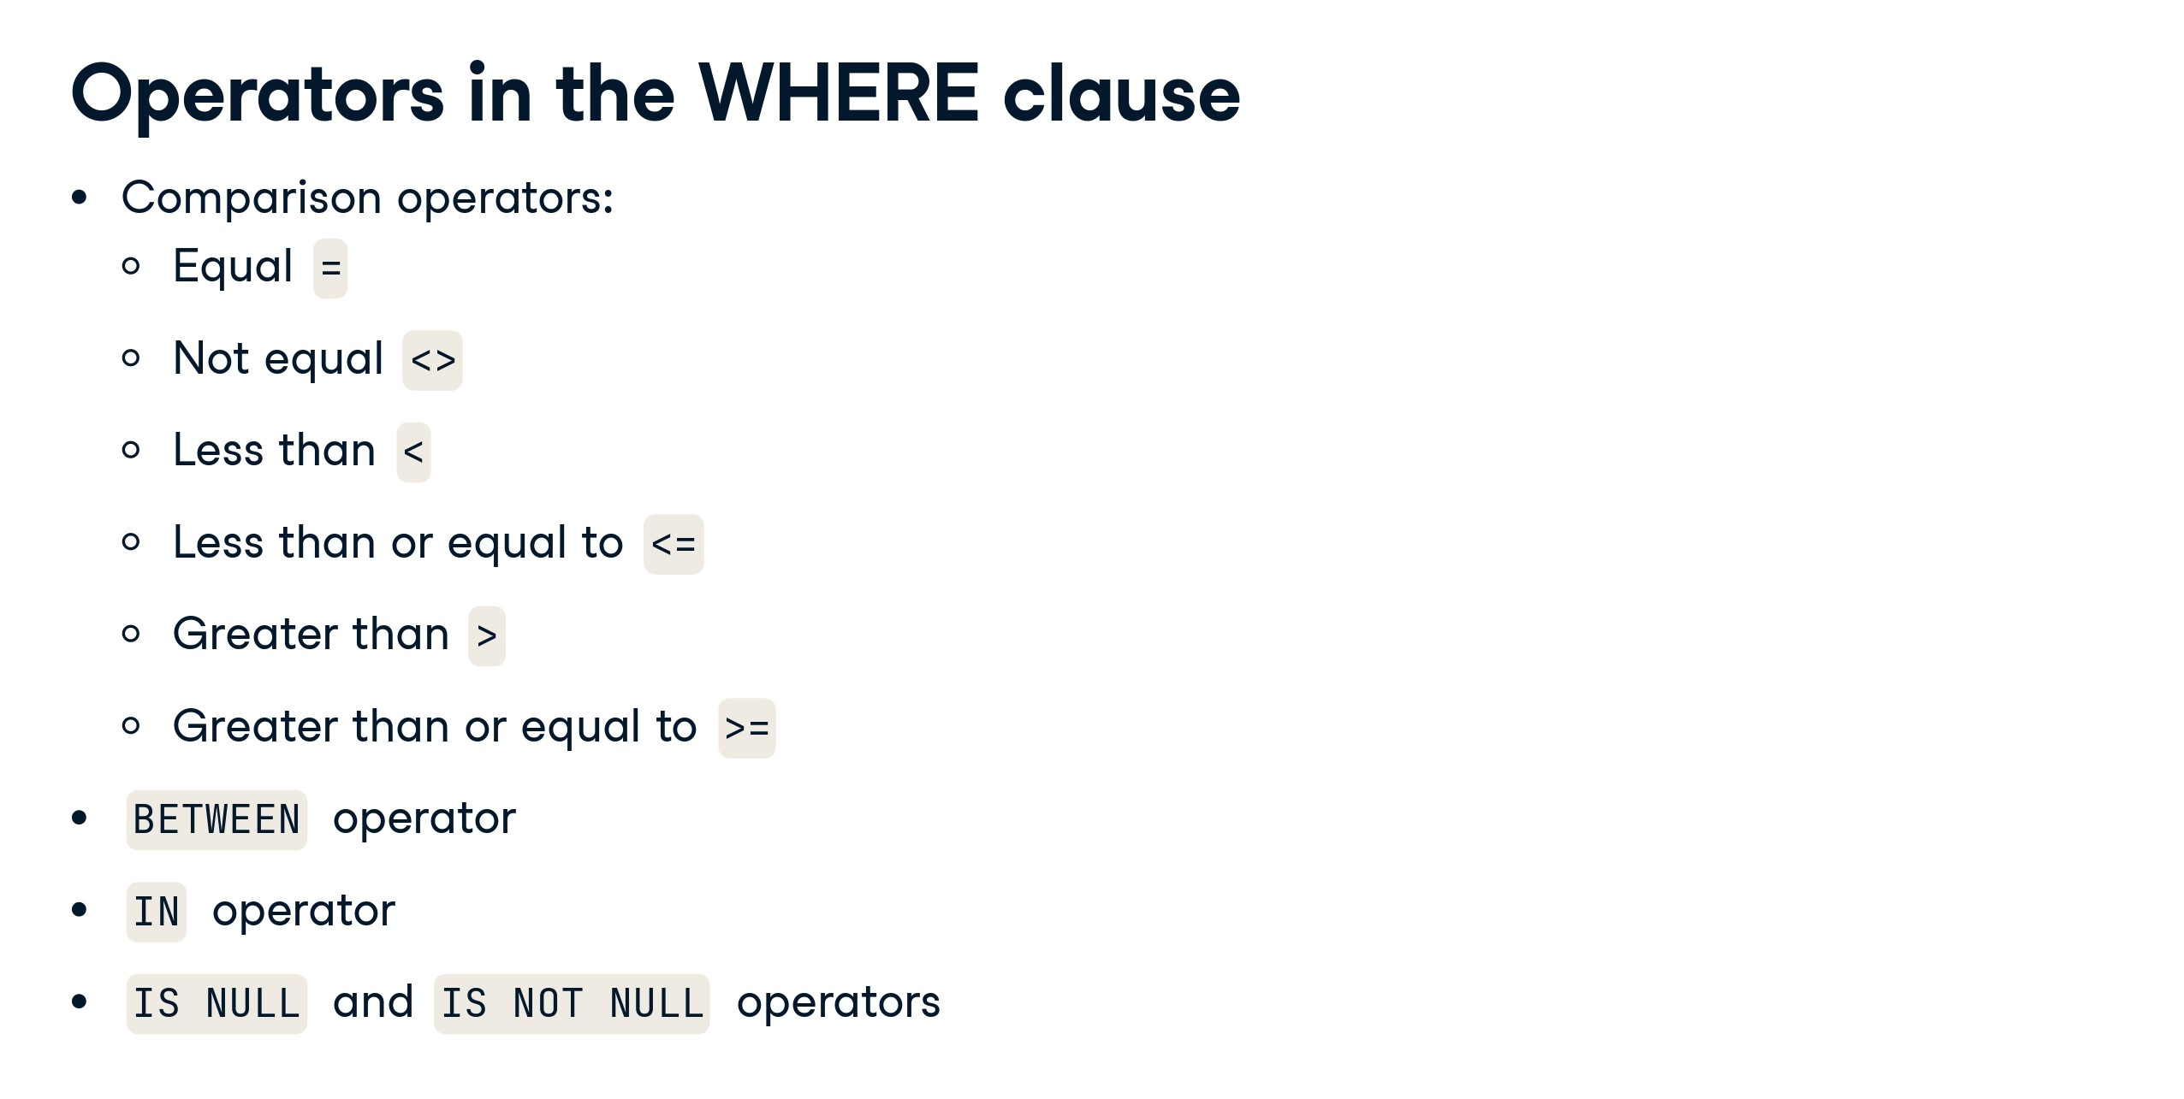

Slide 15
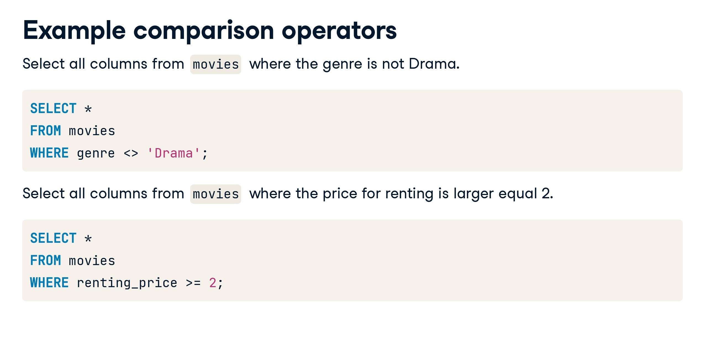

Slide 16
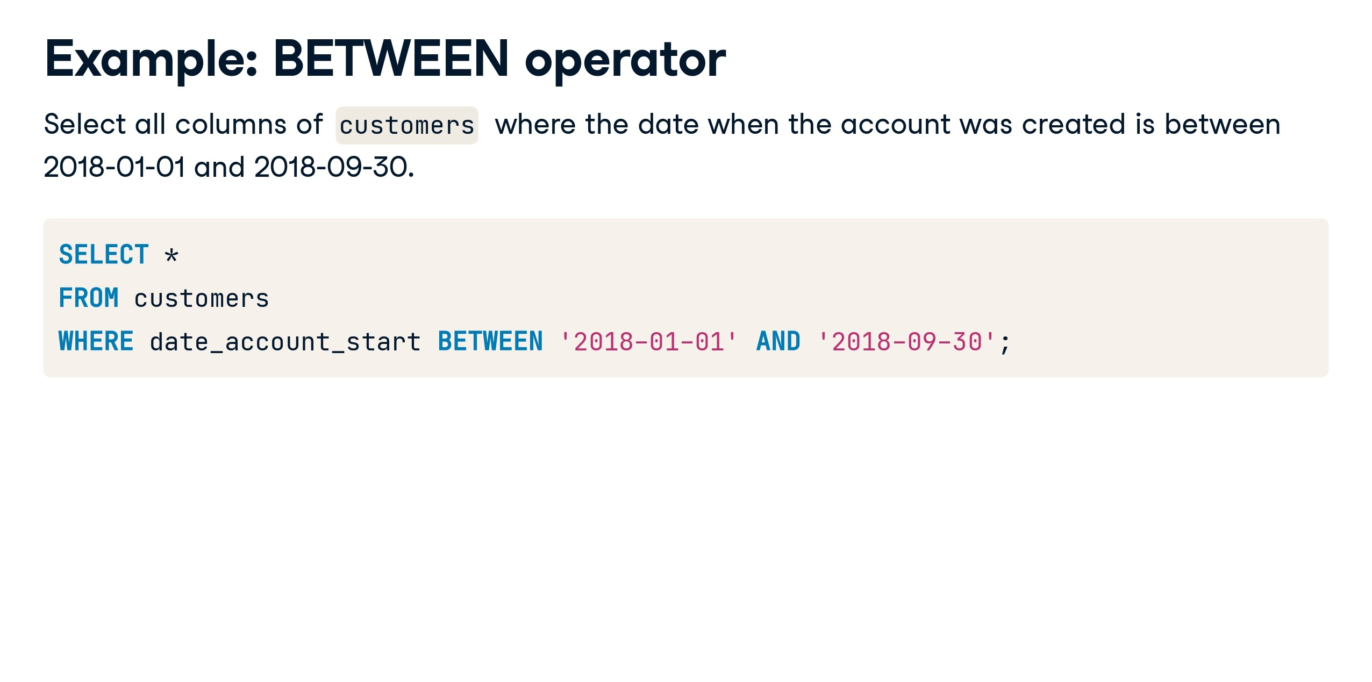

Slide 17
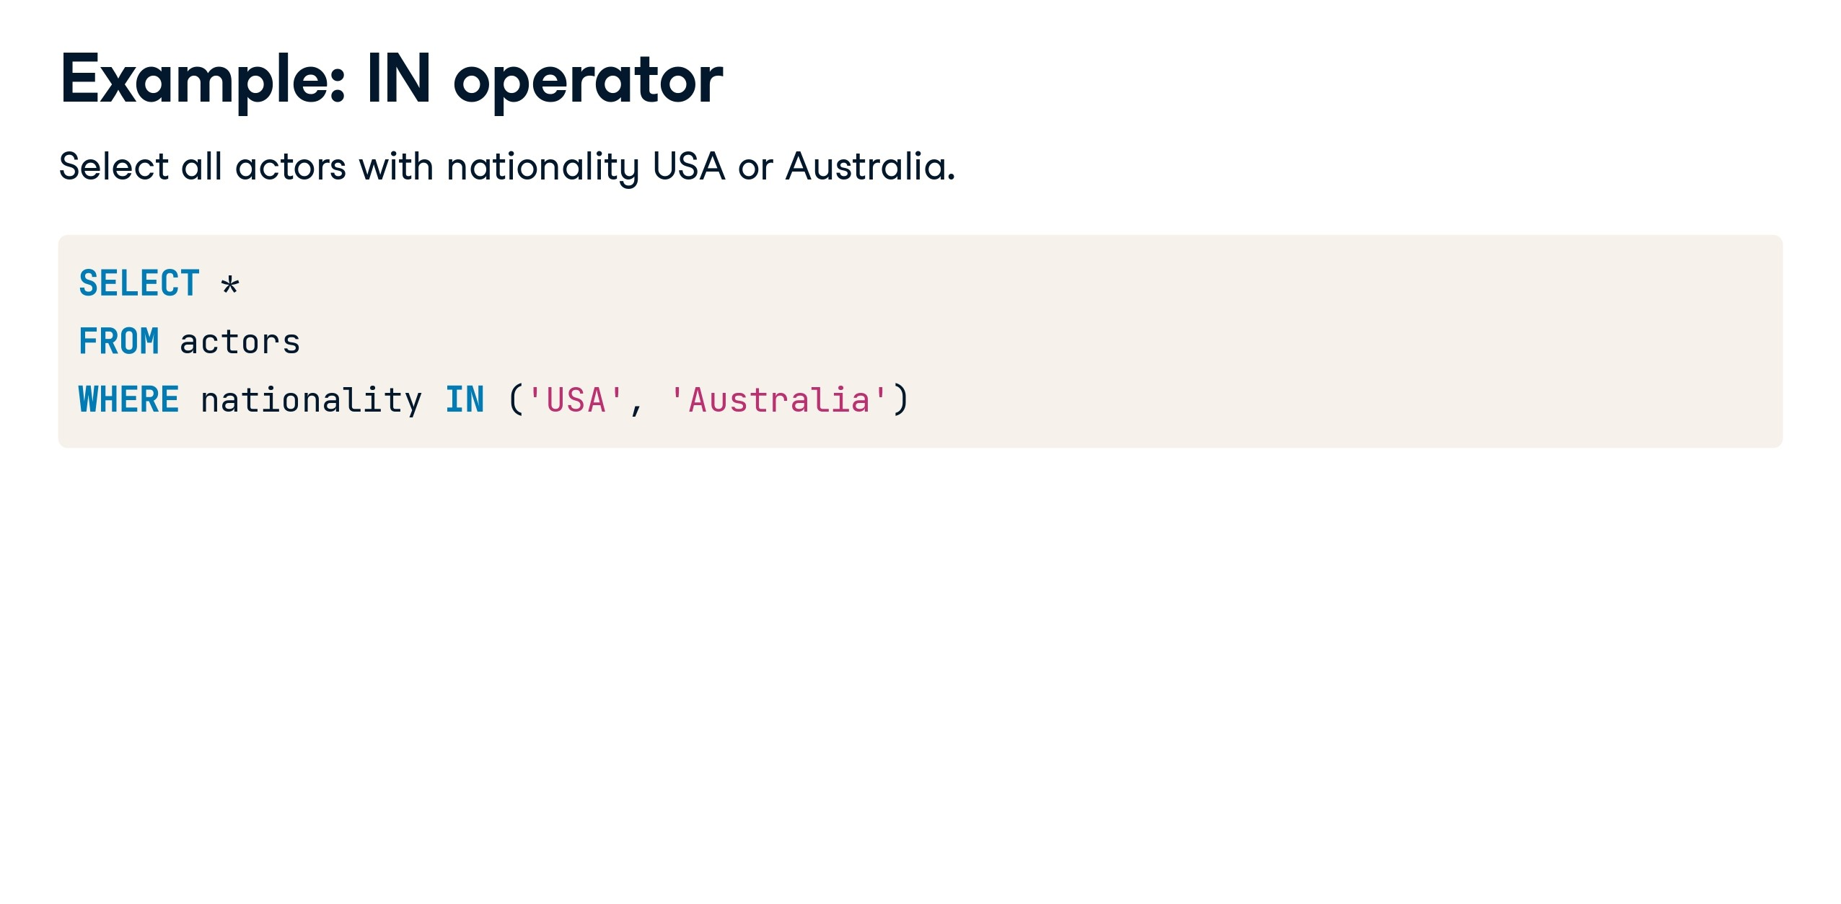

Slide 18
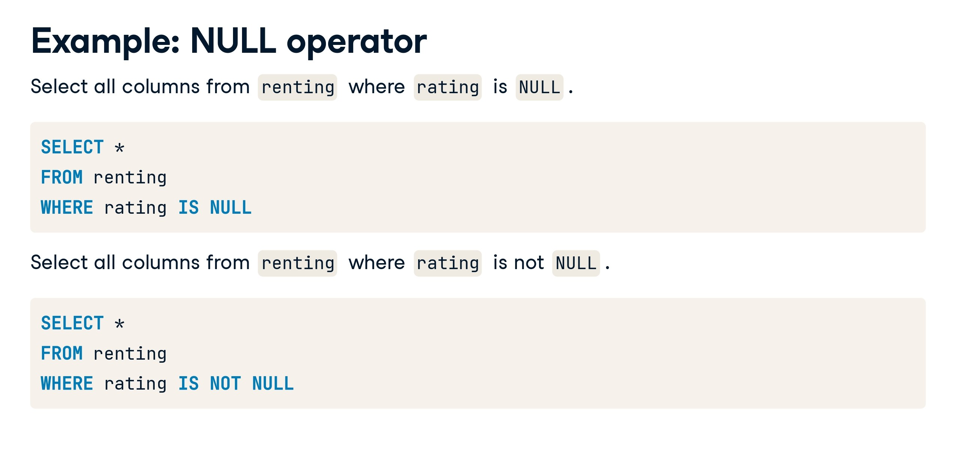

Slide 19
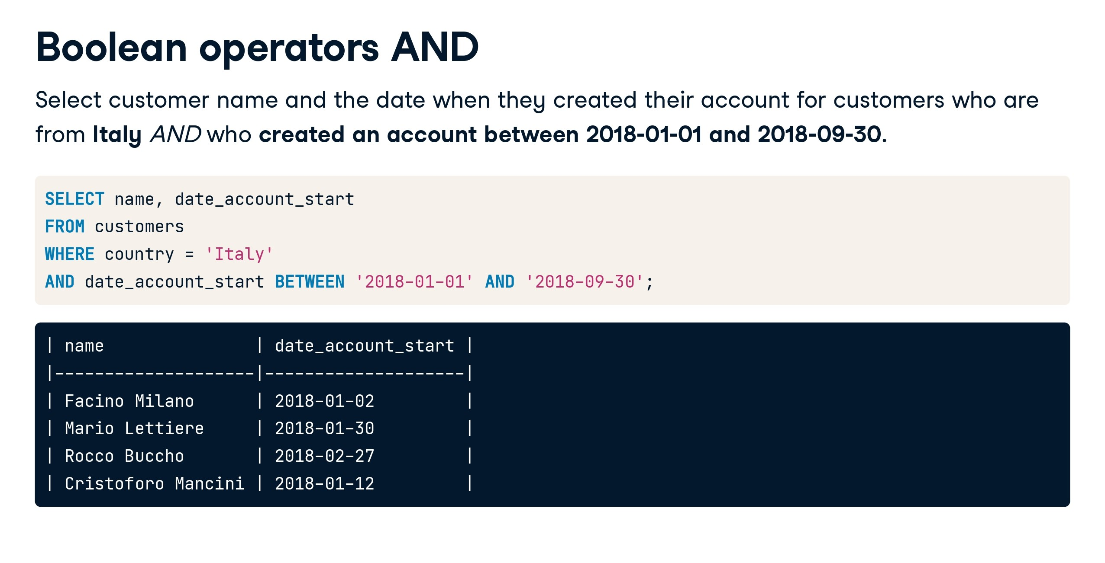

Slide 20
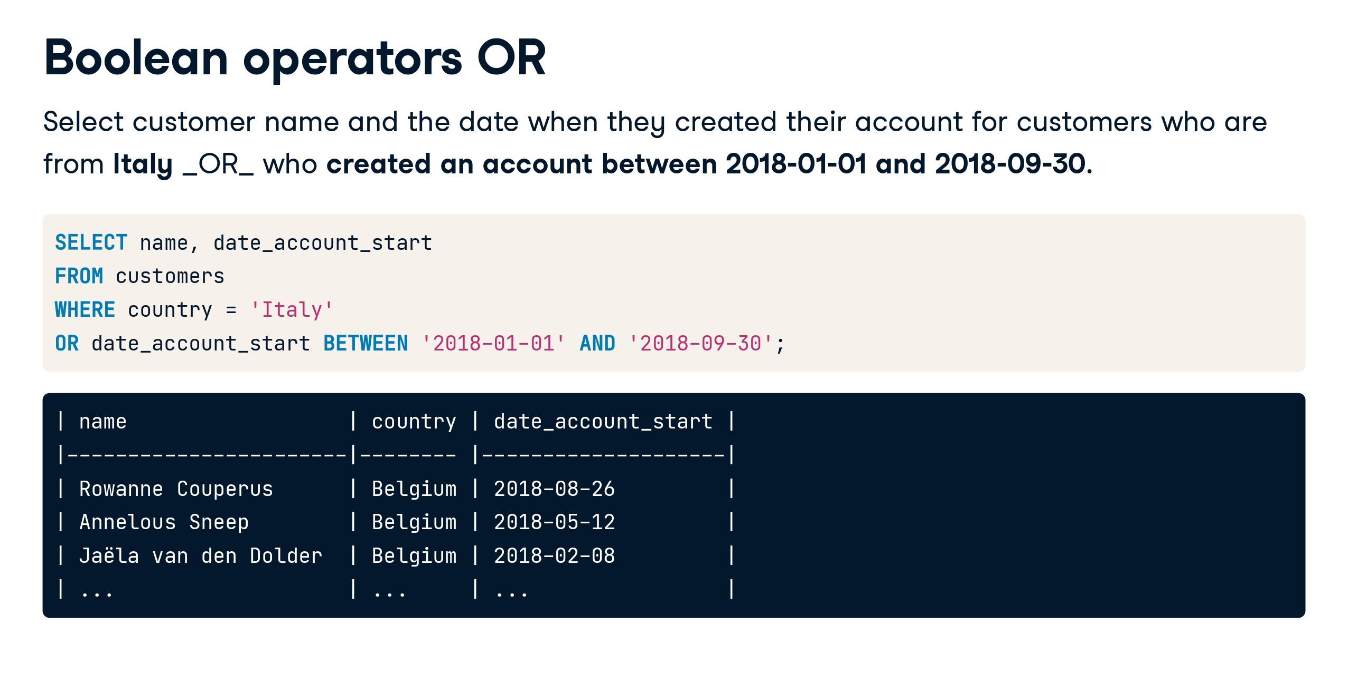

Slide 21
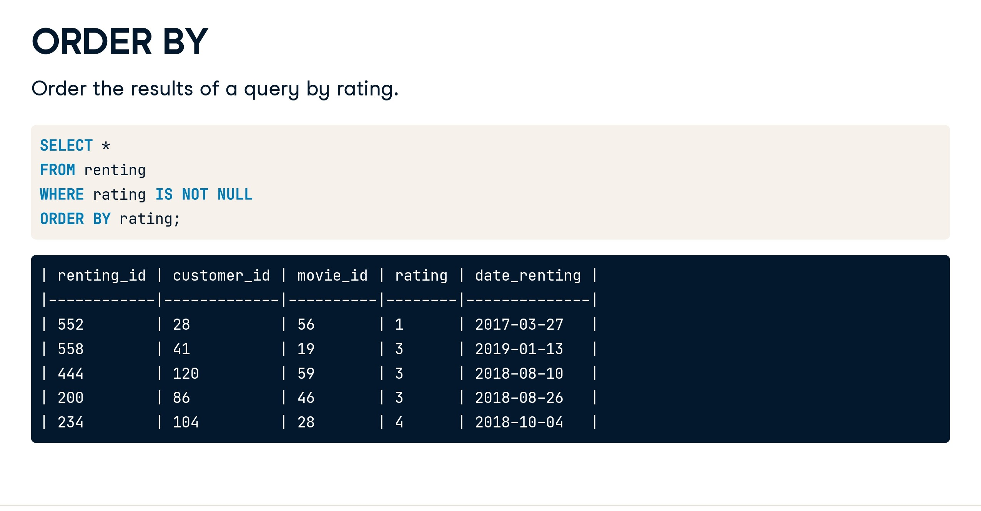

Slide 22
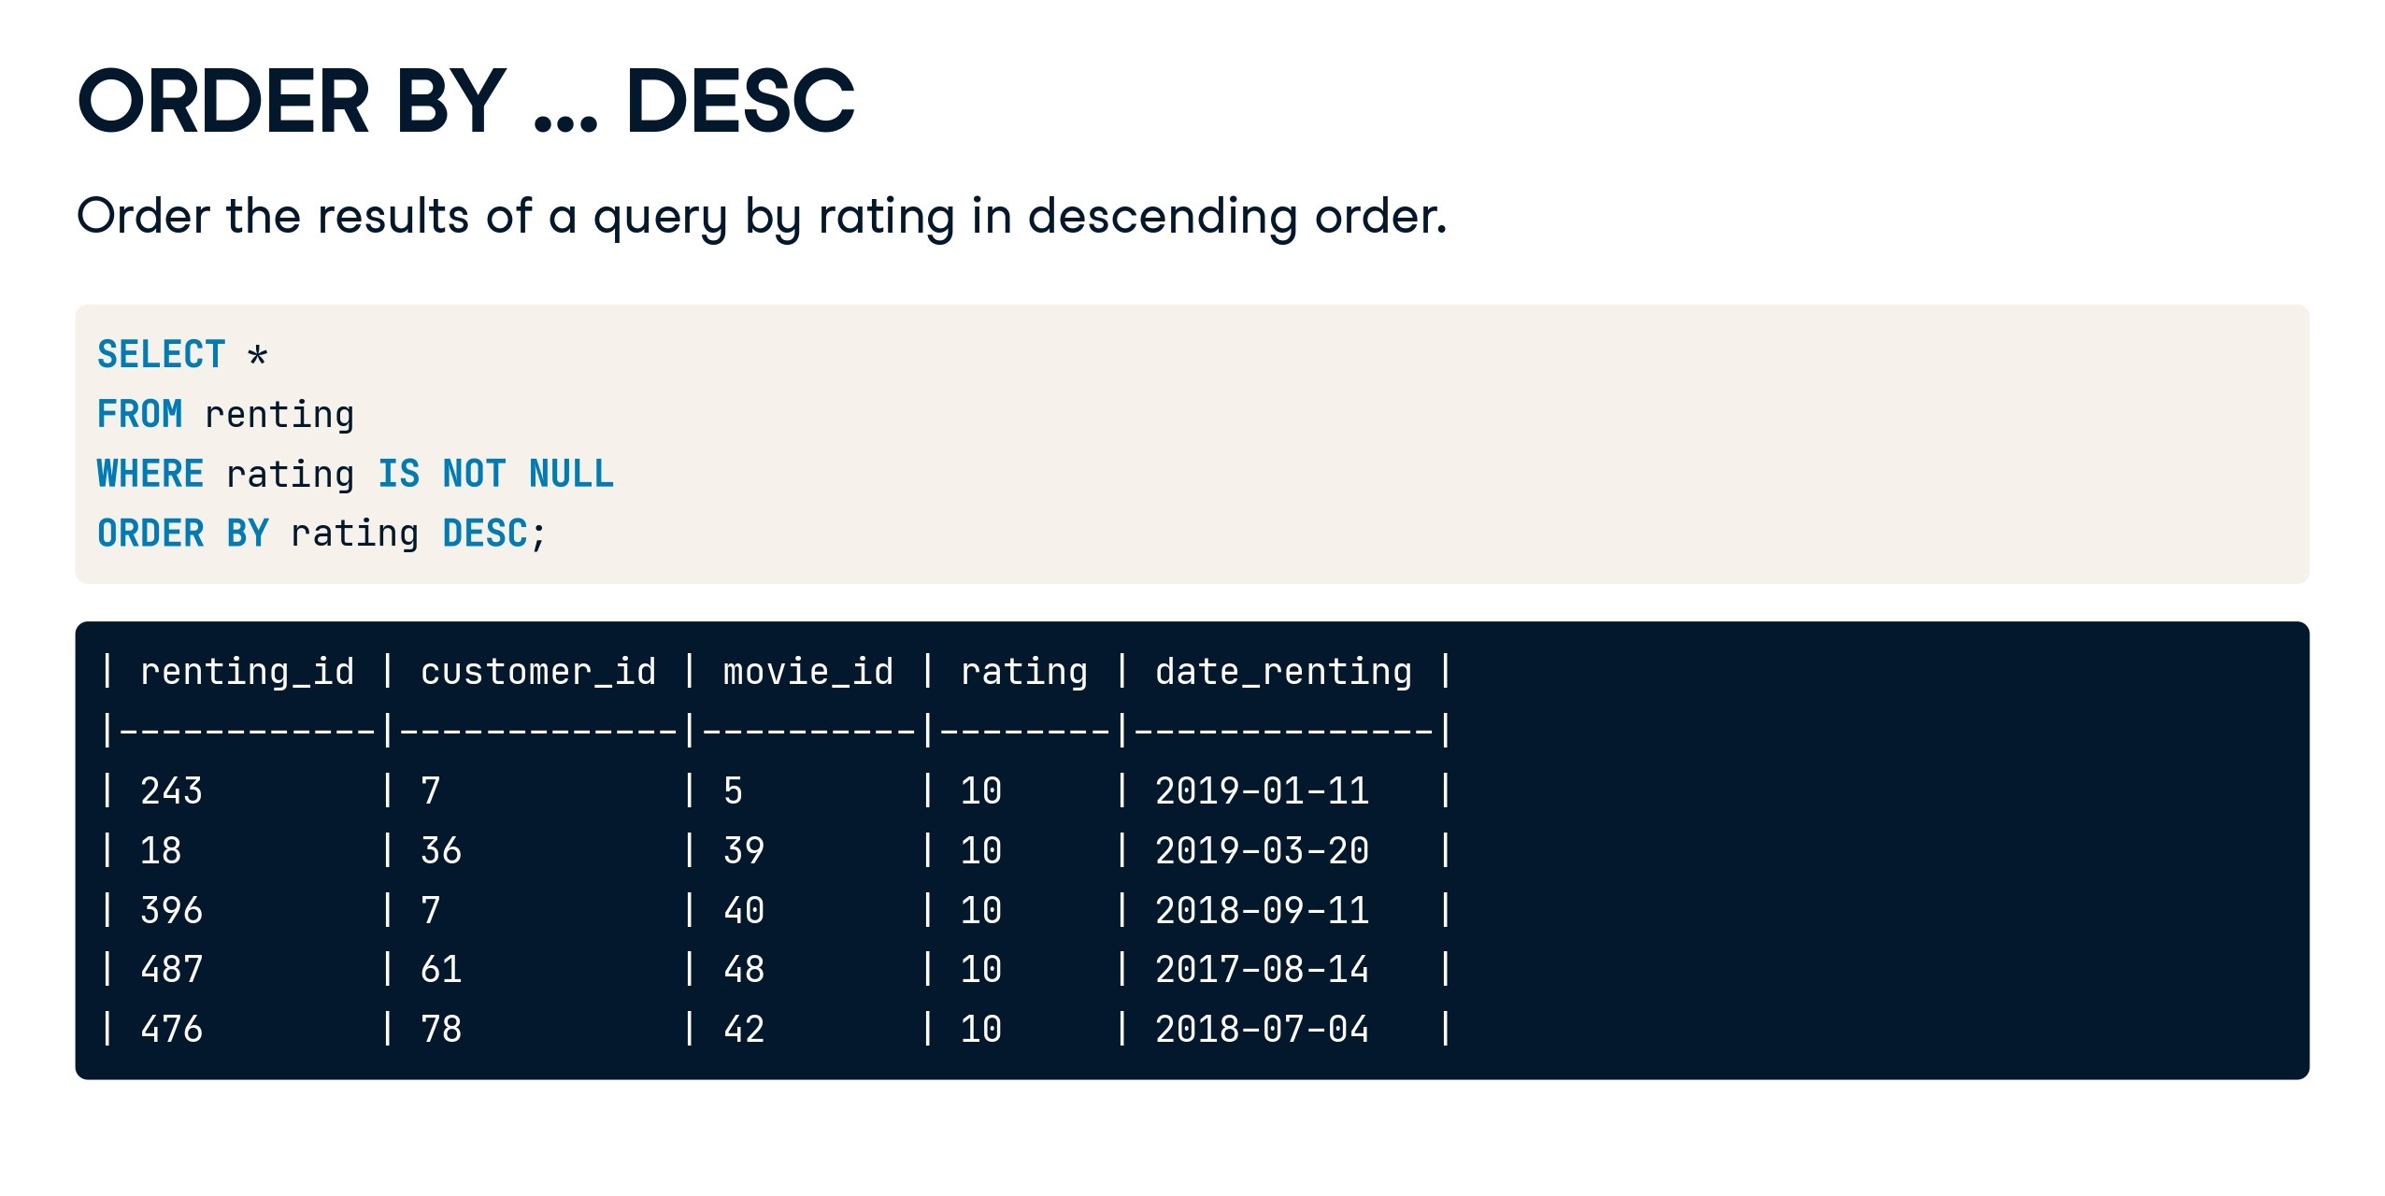

Slide 23


Slide 24
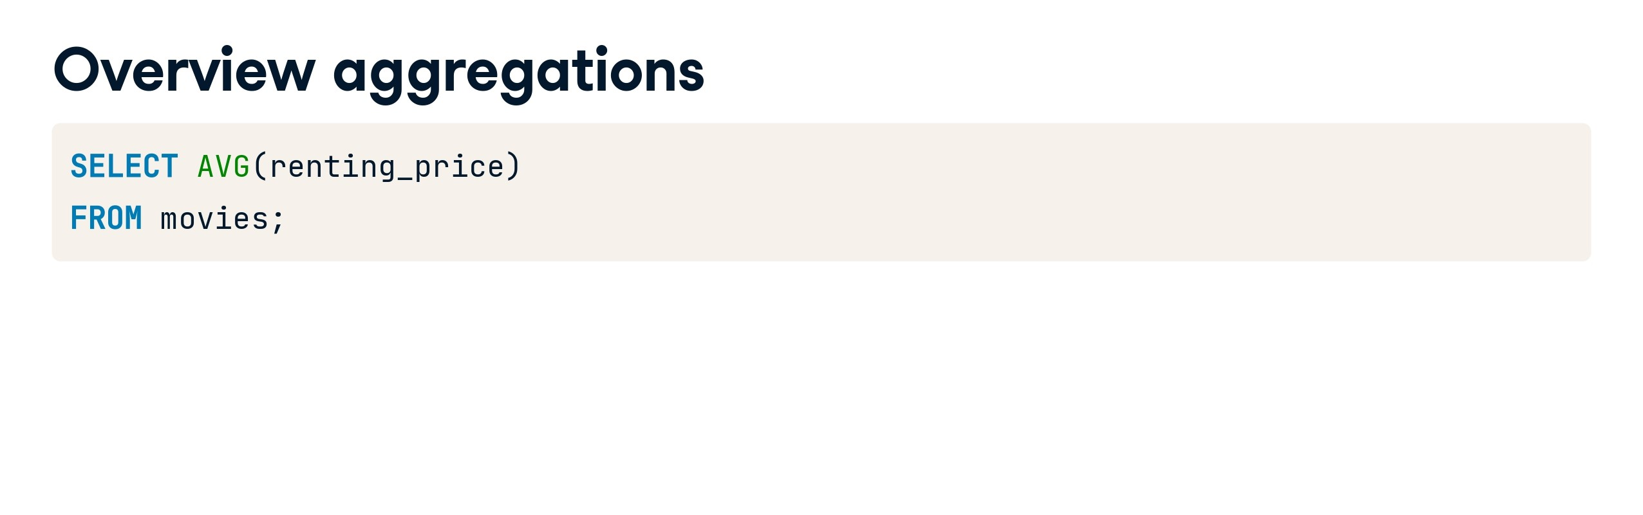

Slide 25
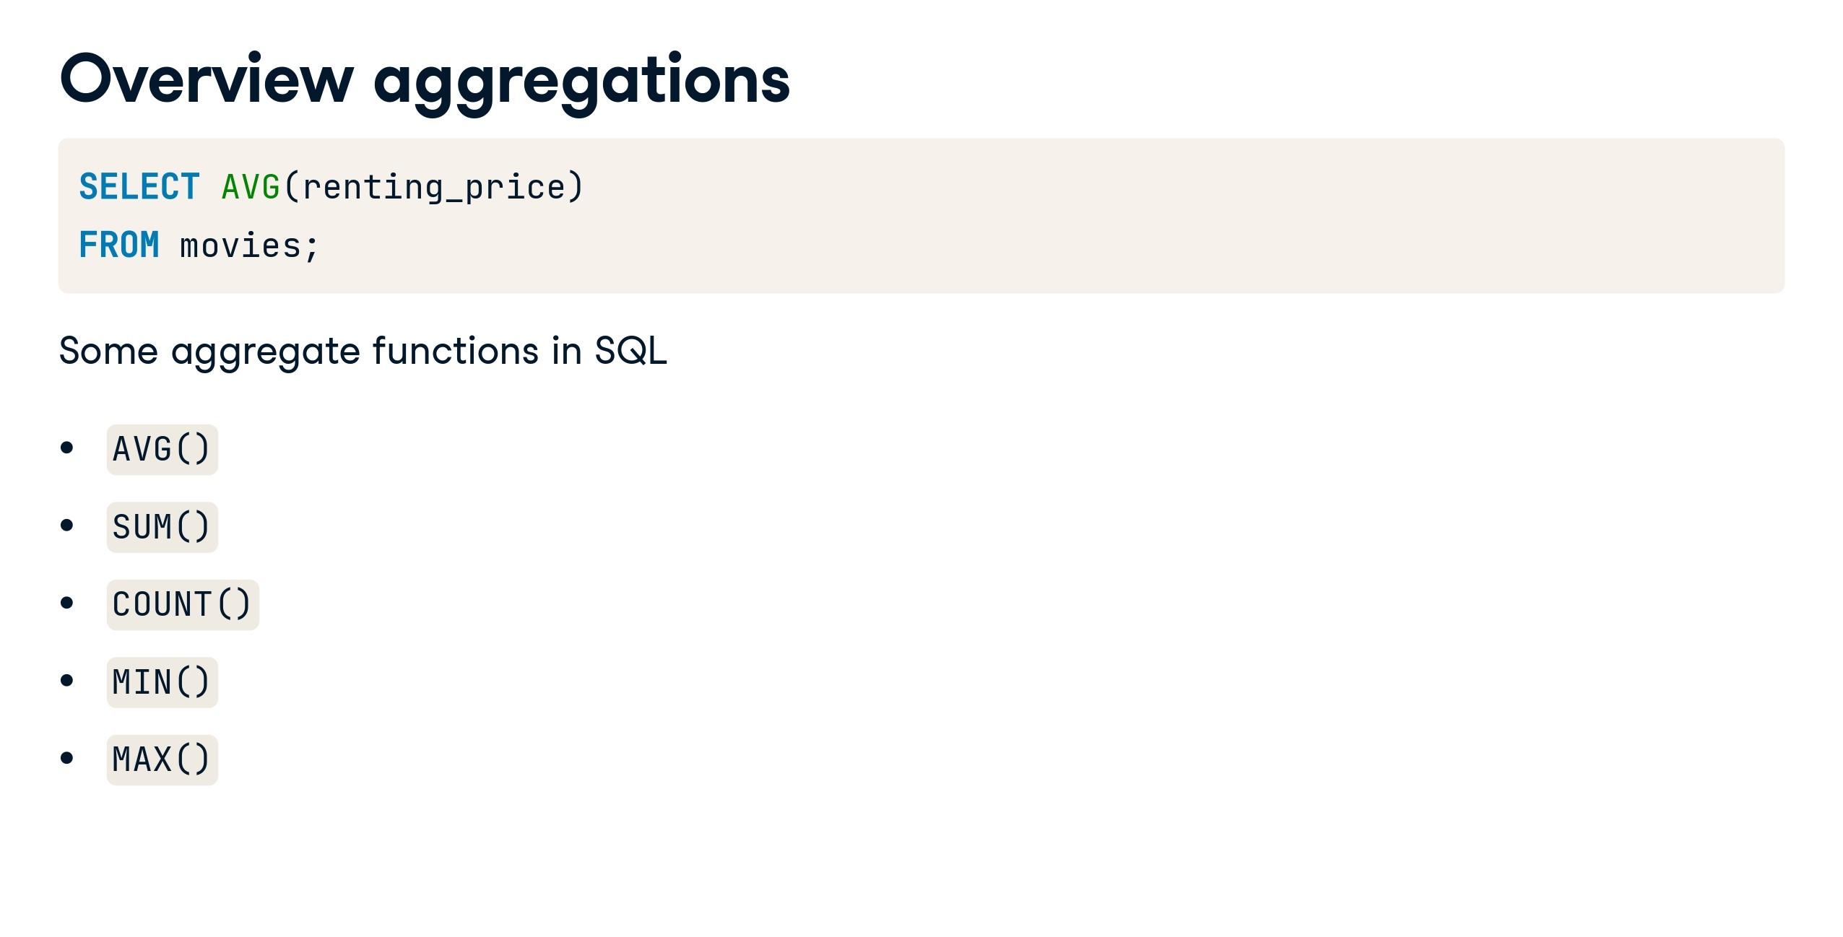

Slide 26
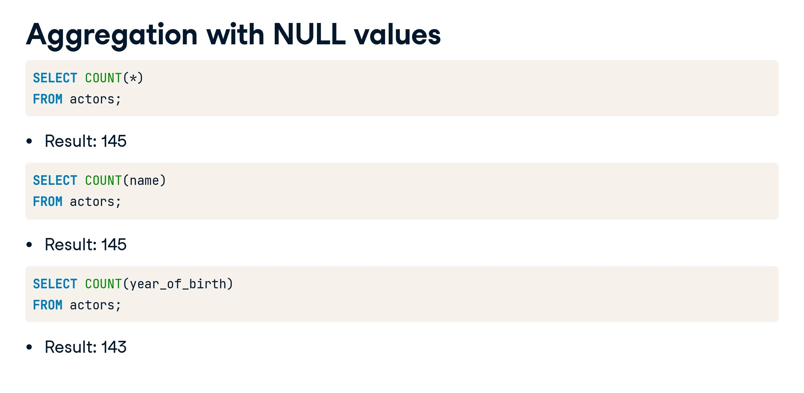

Slide 27
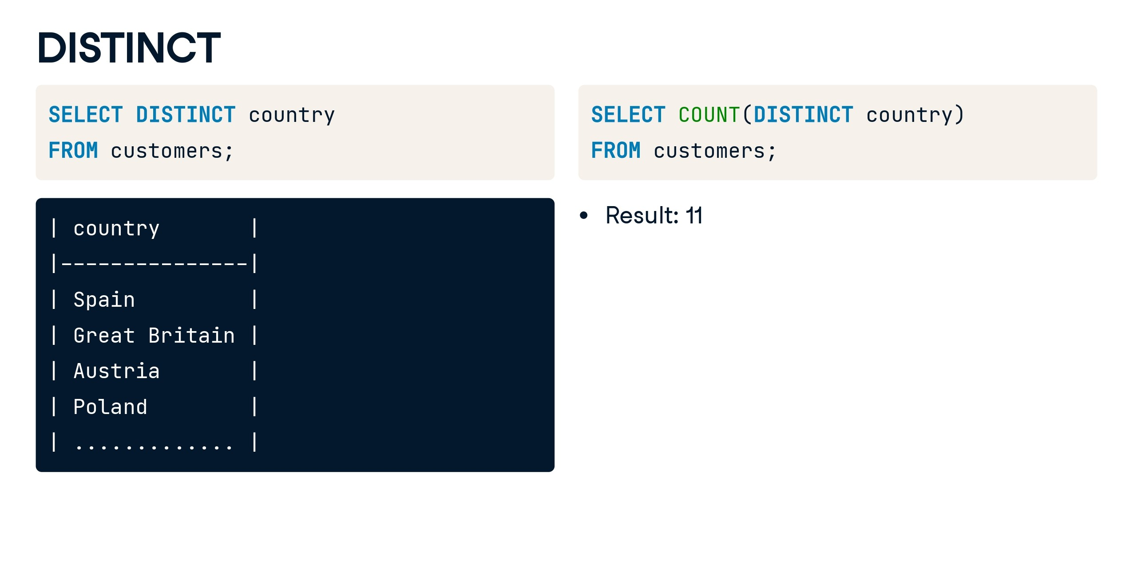

Slide 28
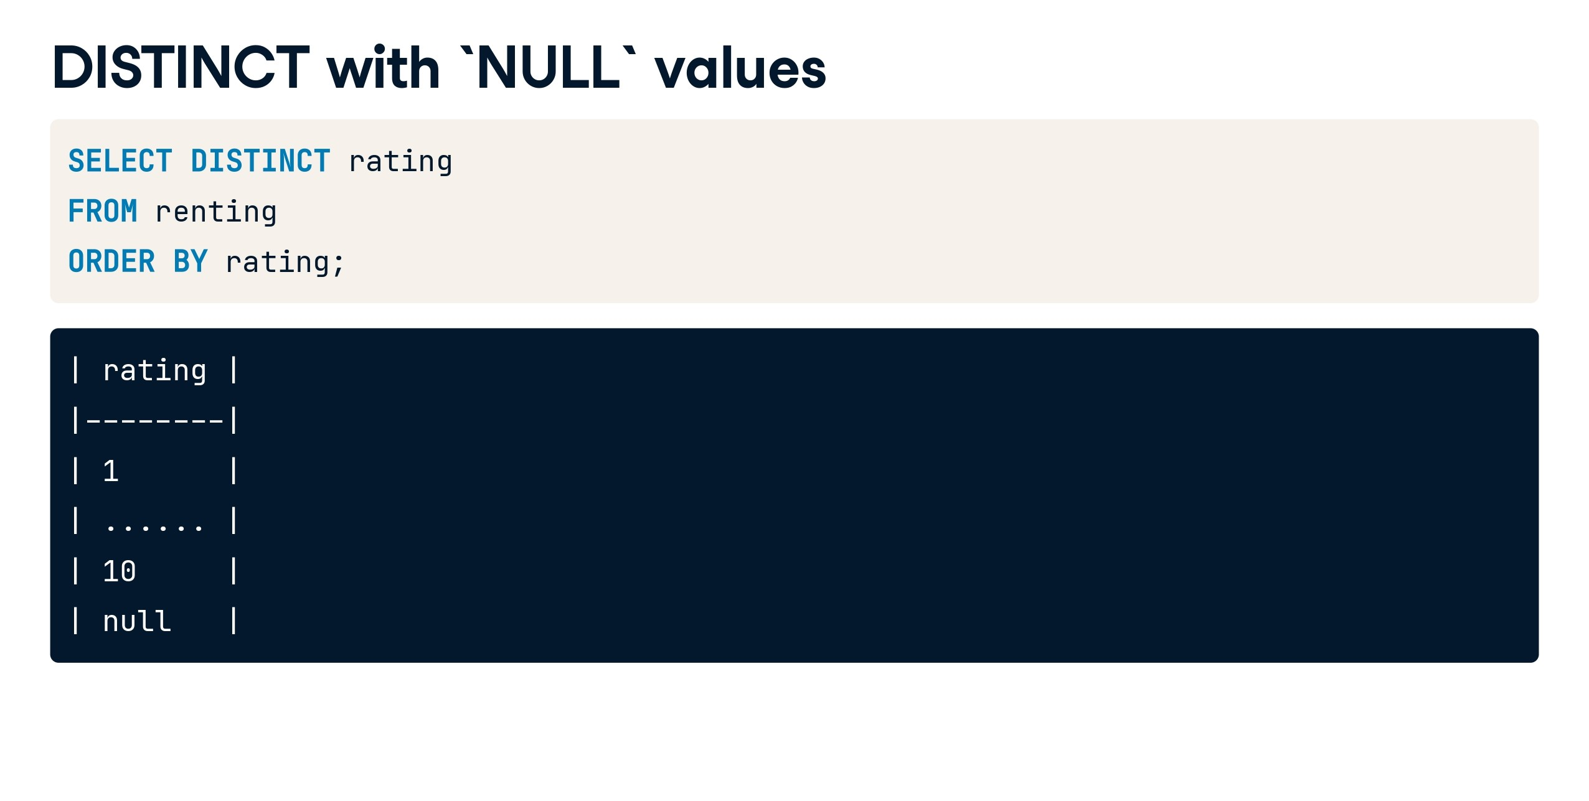

Slide 29
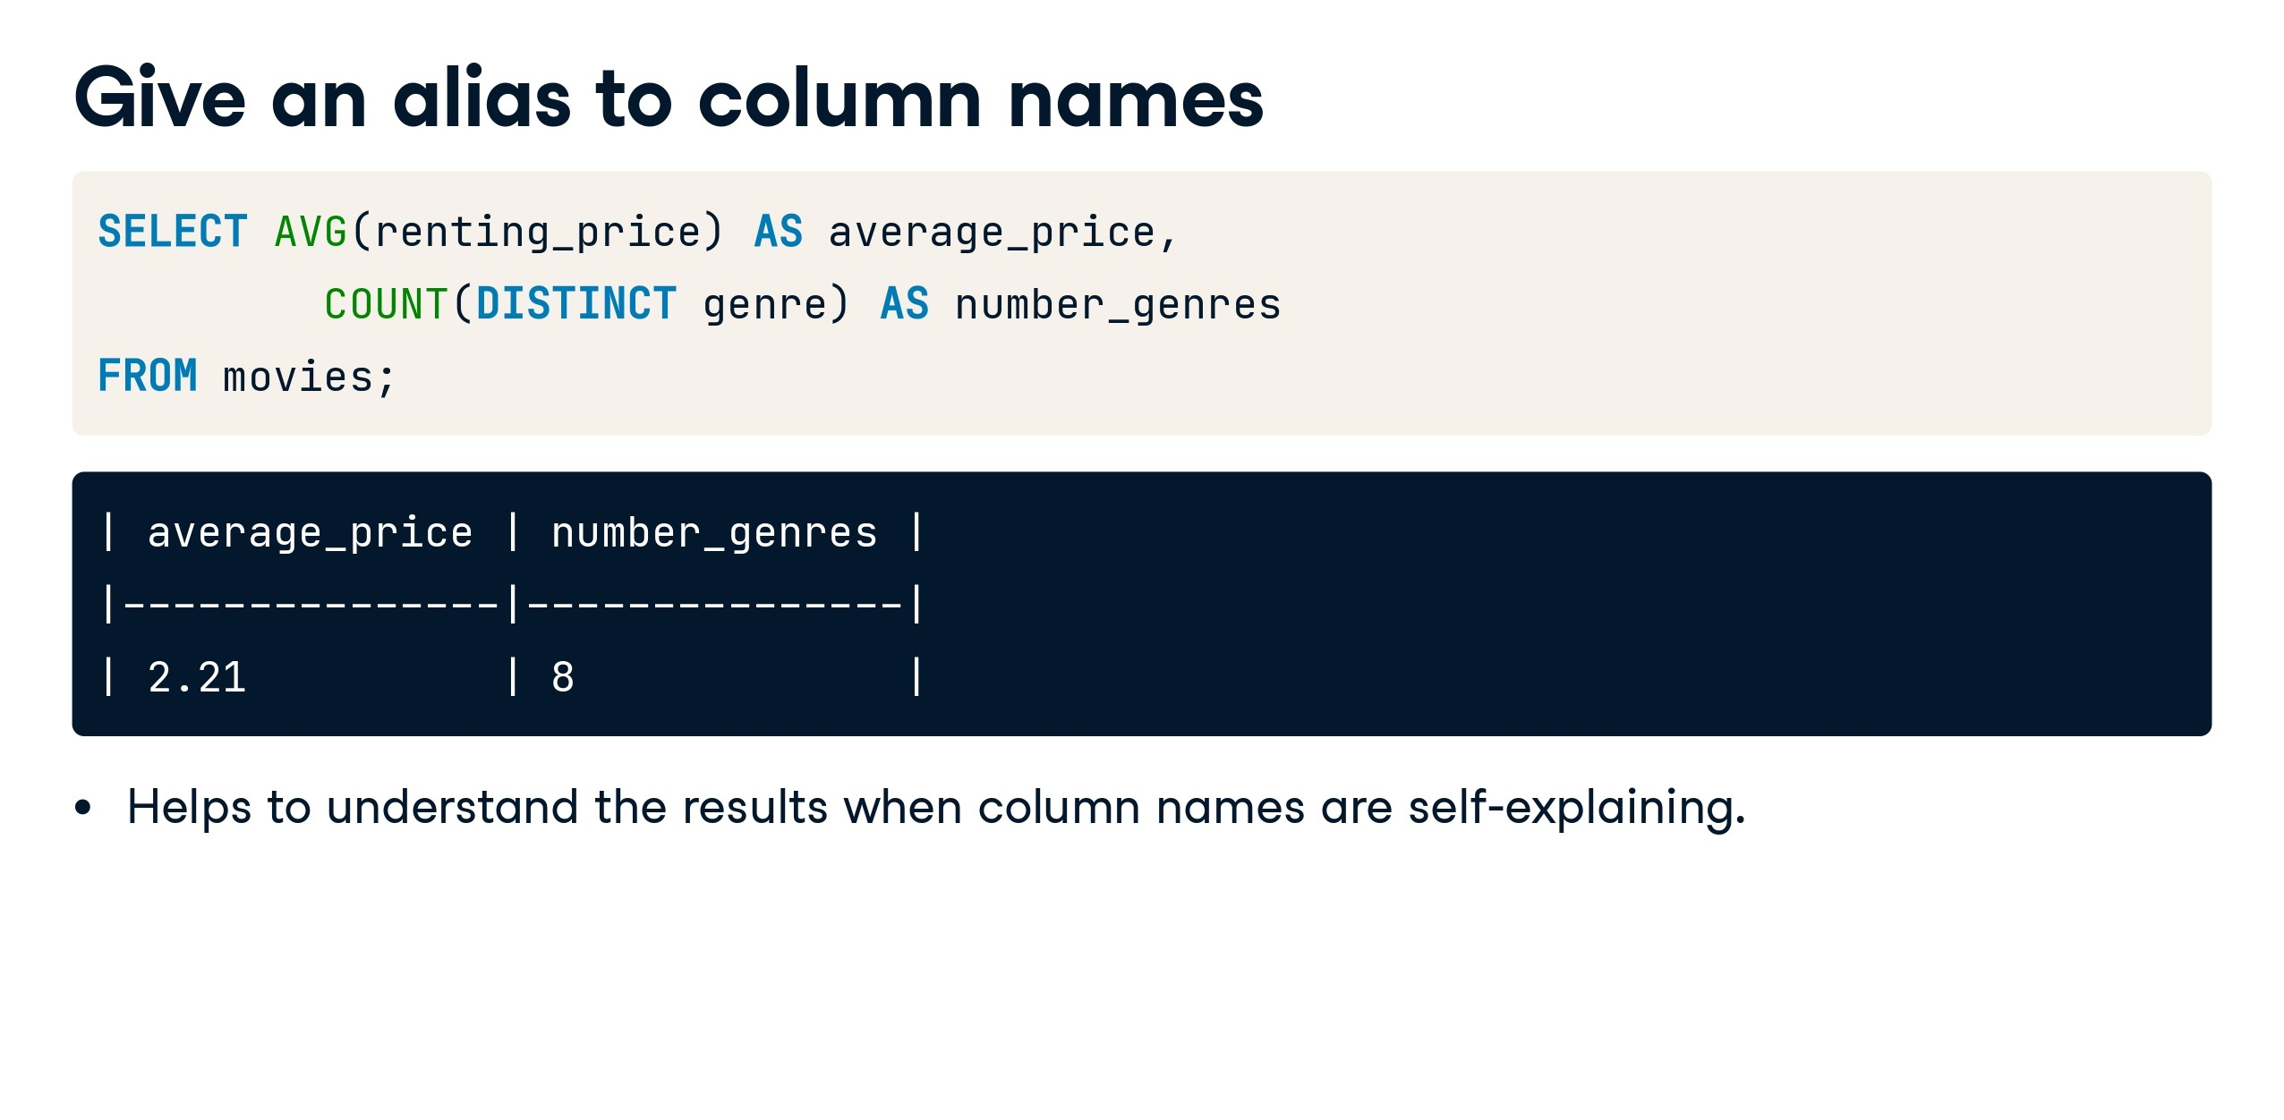

Slide 30
SQL Day 7 Part 2

Slide 31


Slide 32


Slide 33
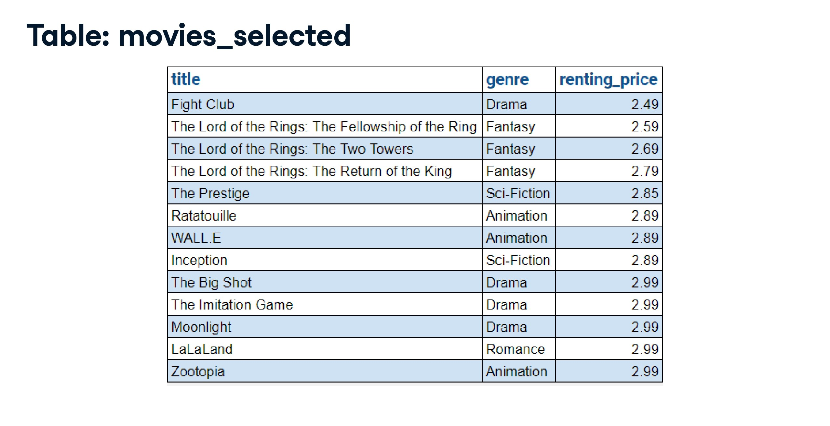

Slide 34
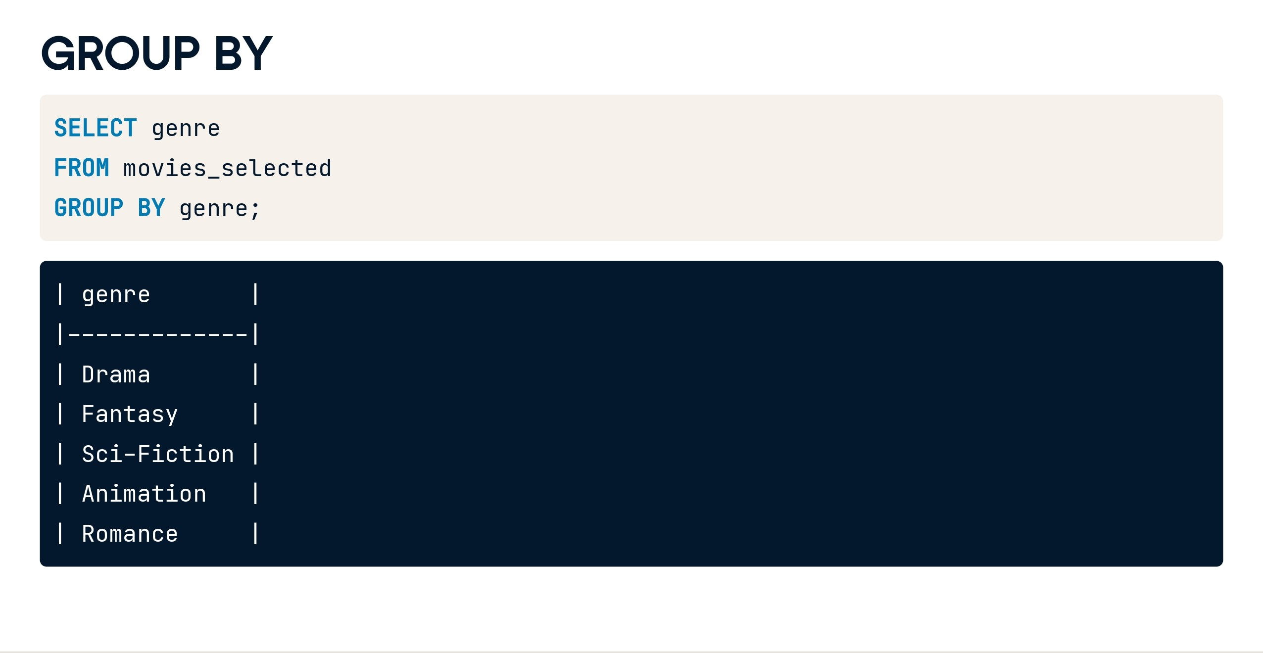

Slide 35
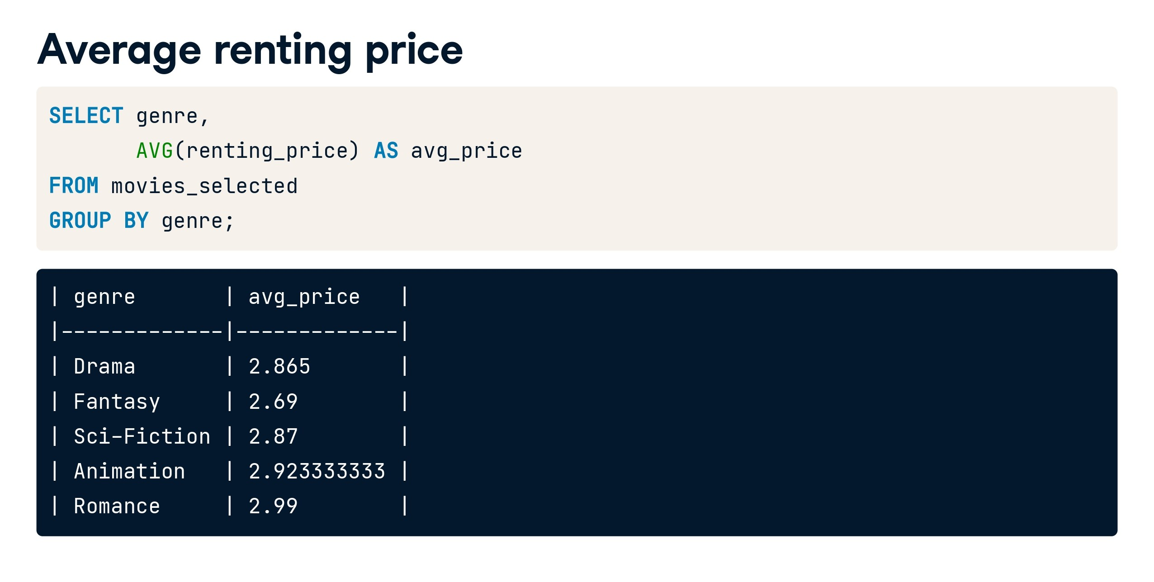

Slide 36
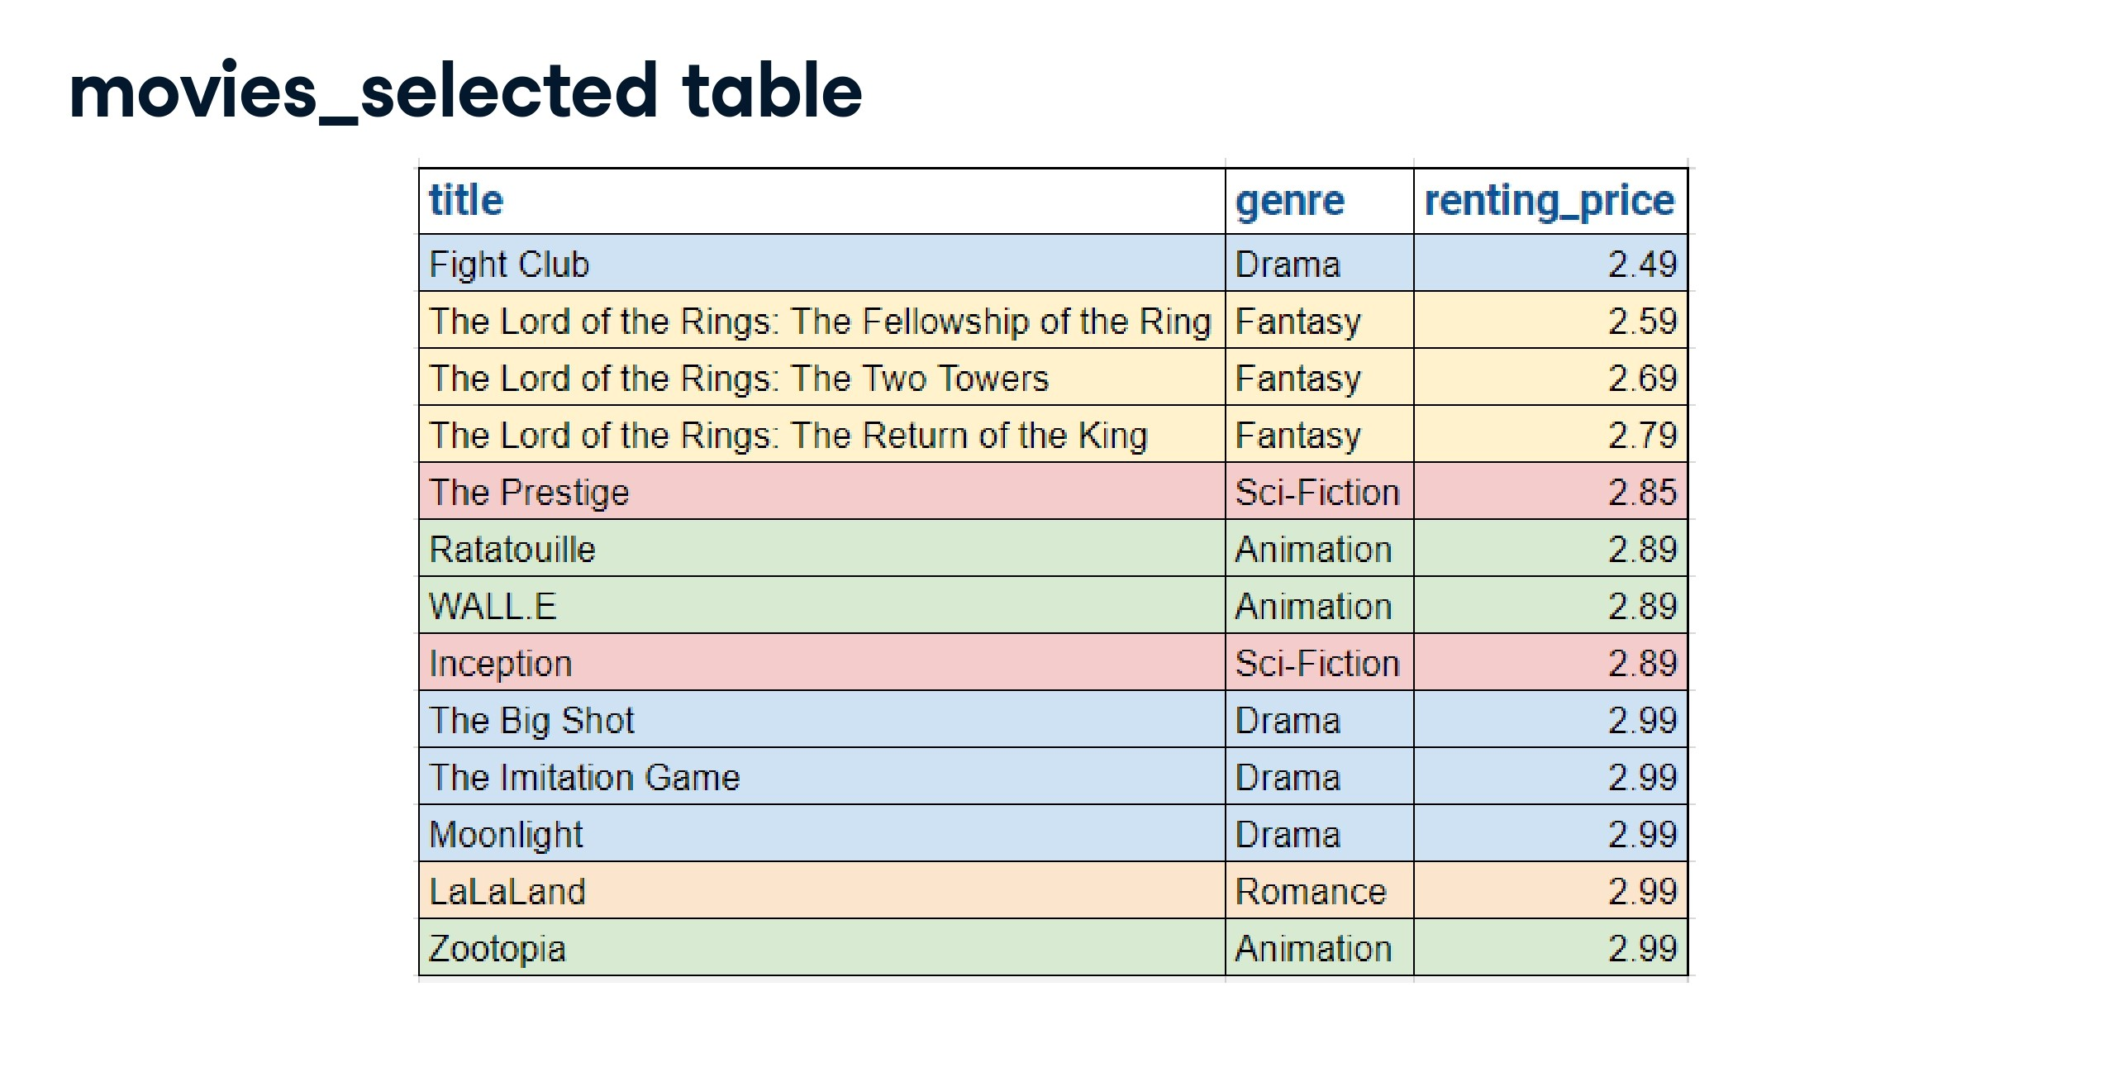

Slide 37
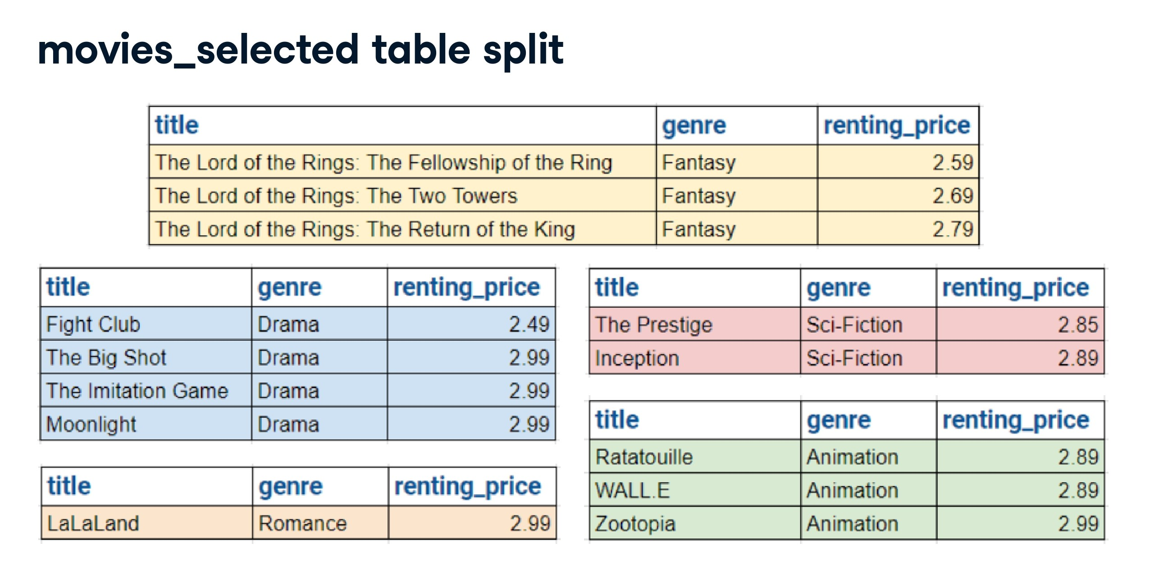

Slide 38
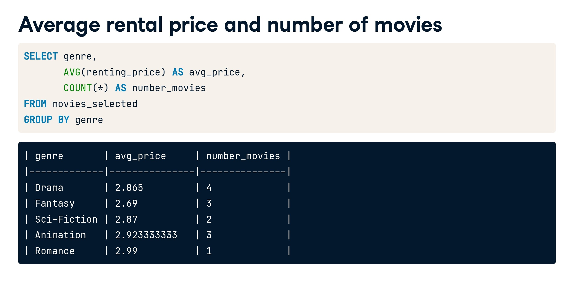

Slide 39
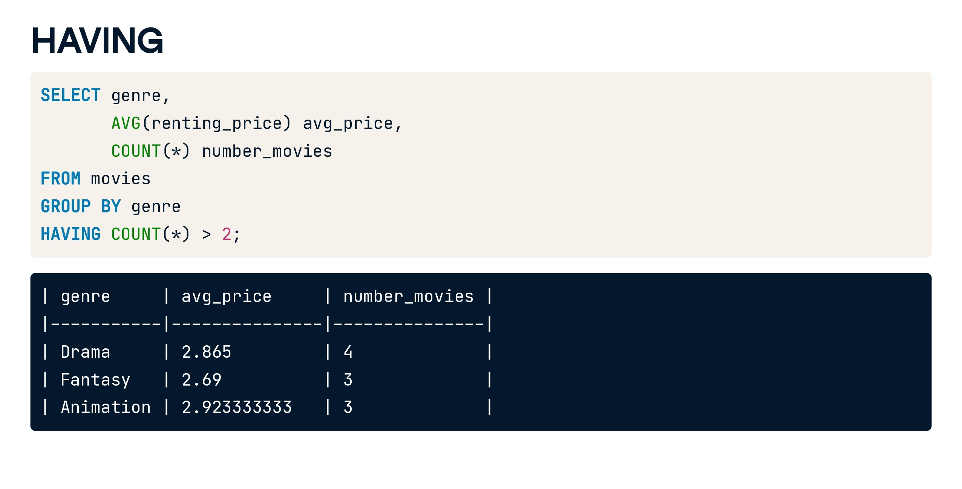

Slide 40


Slide 41
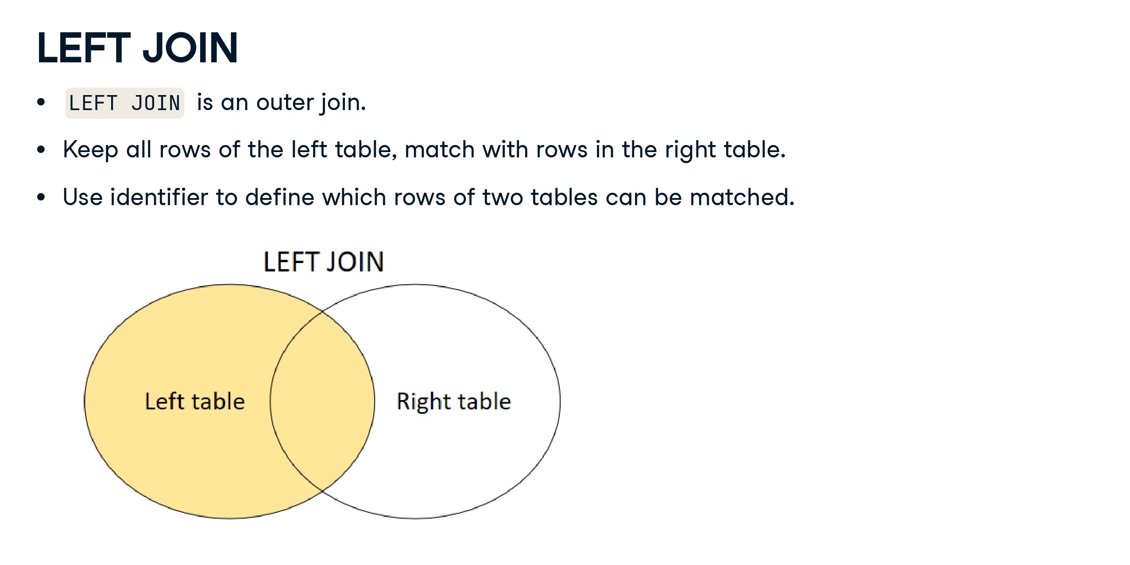

Slide 42
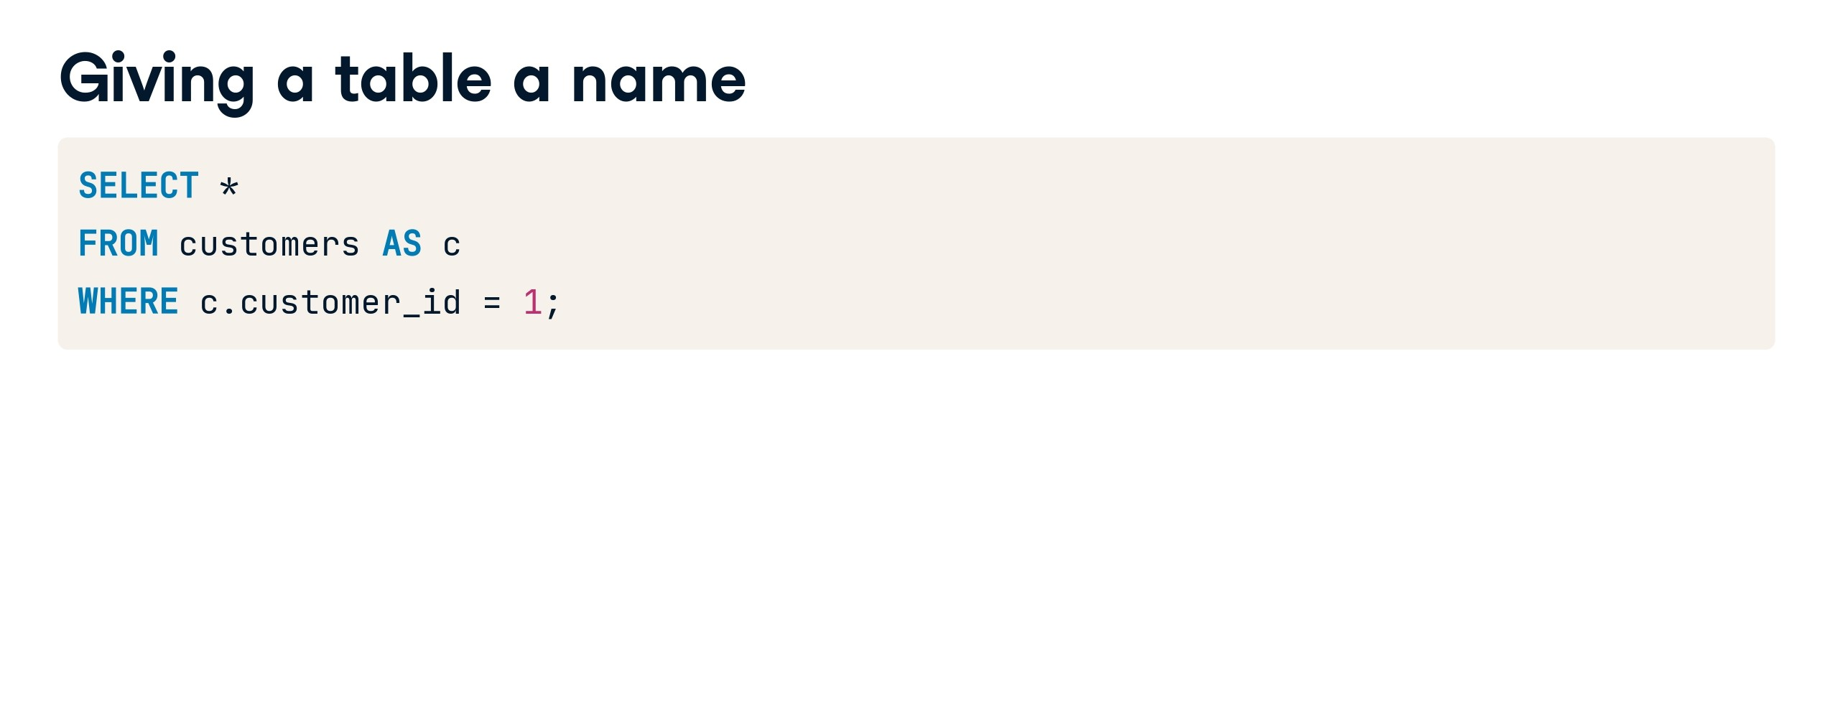

Slide 43
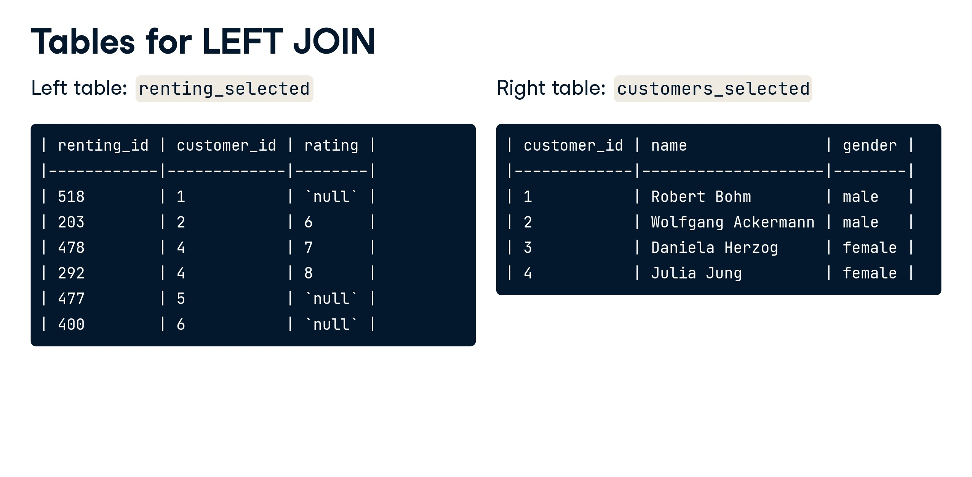

Slide 44
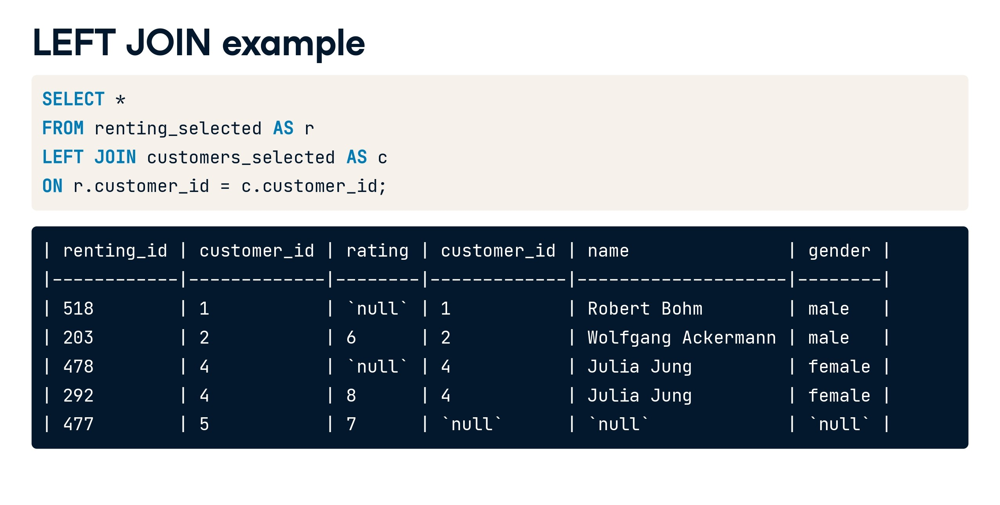

Slide 45
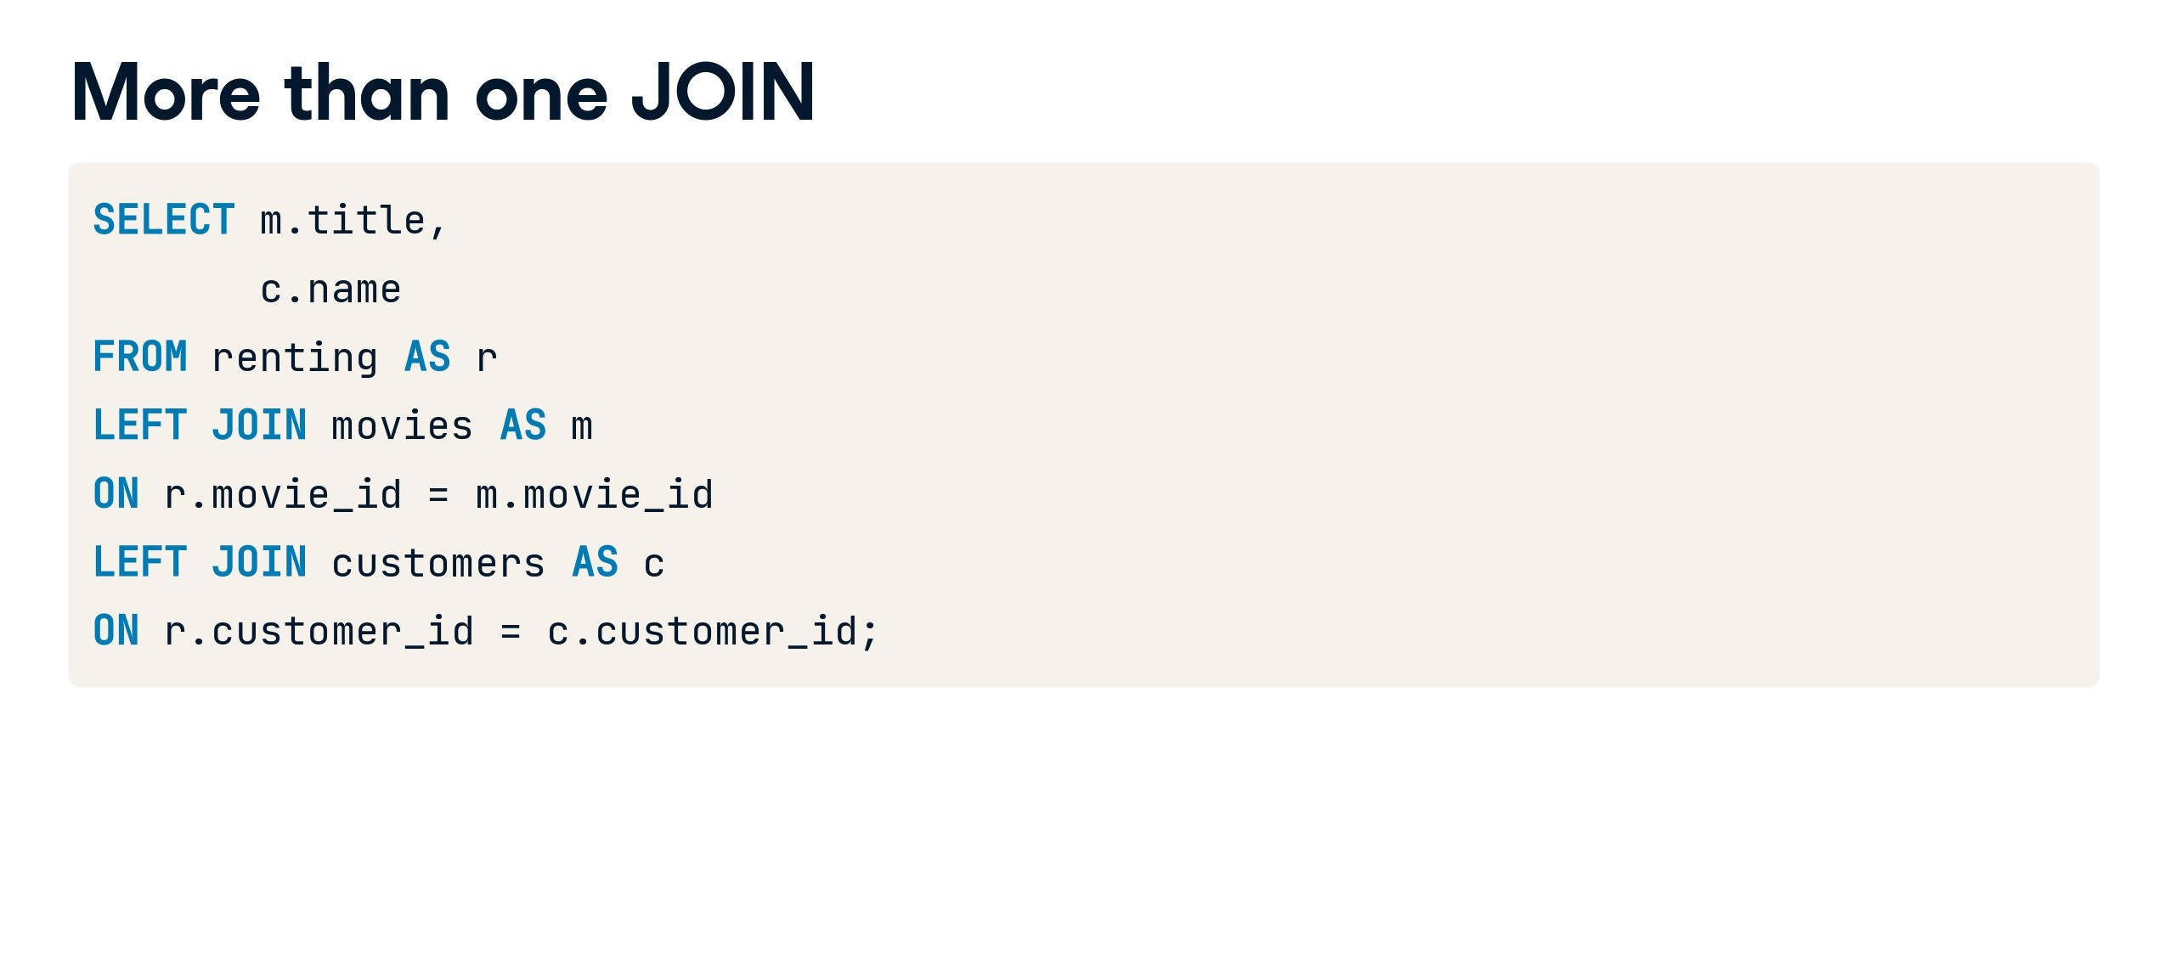

Slide 46


Slide 47


Slide 48
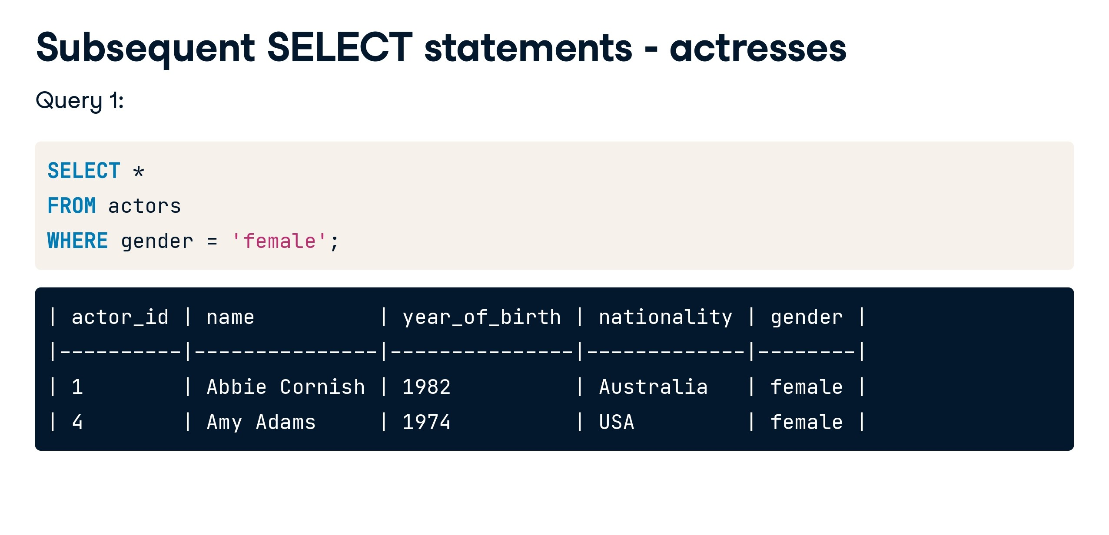

Slide 49
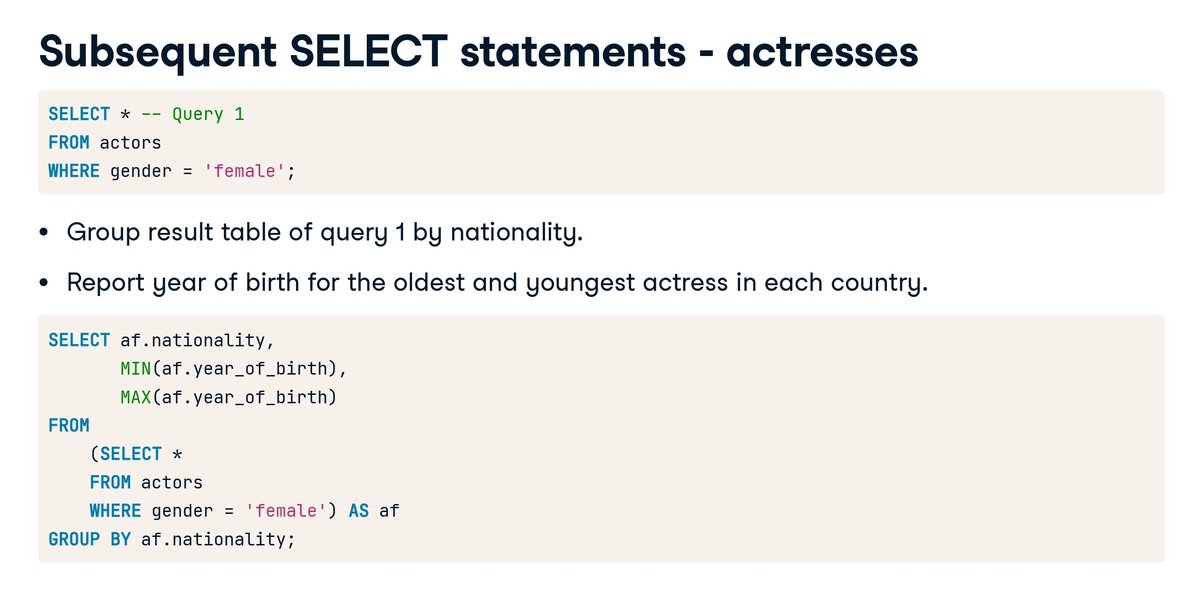

Slide 50
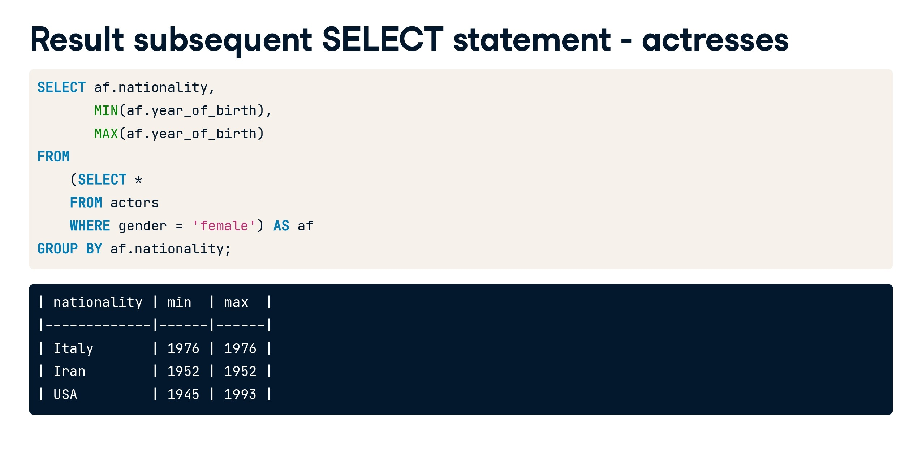

Slide 51
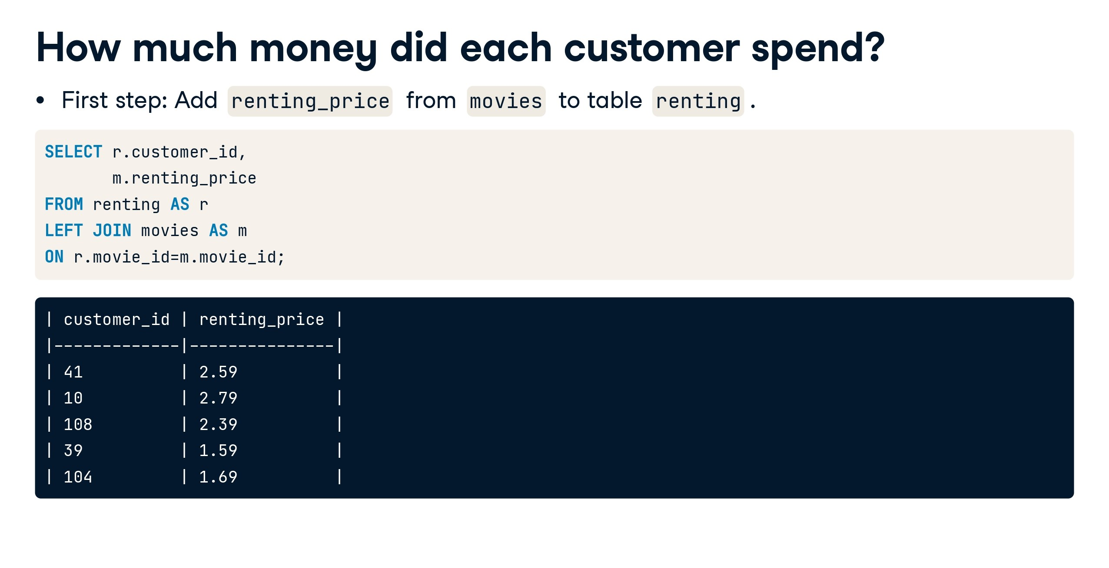

Slide 52
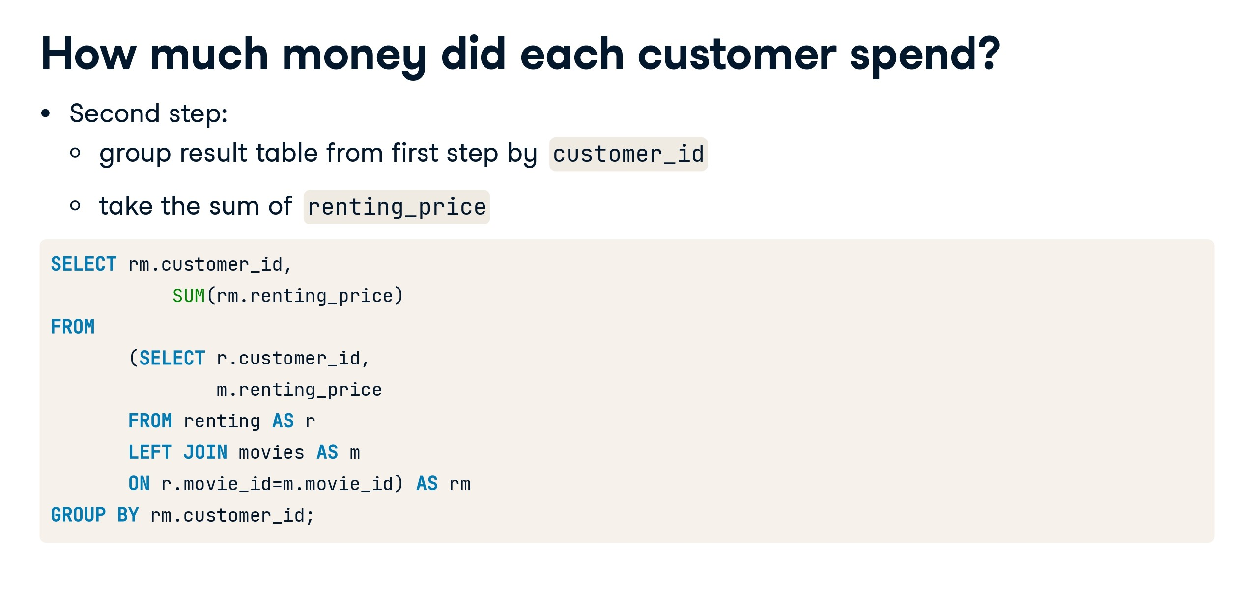

Slide 53
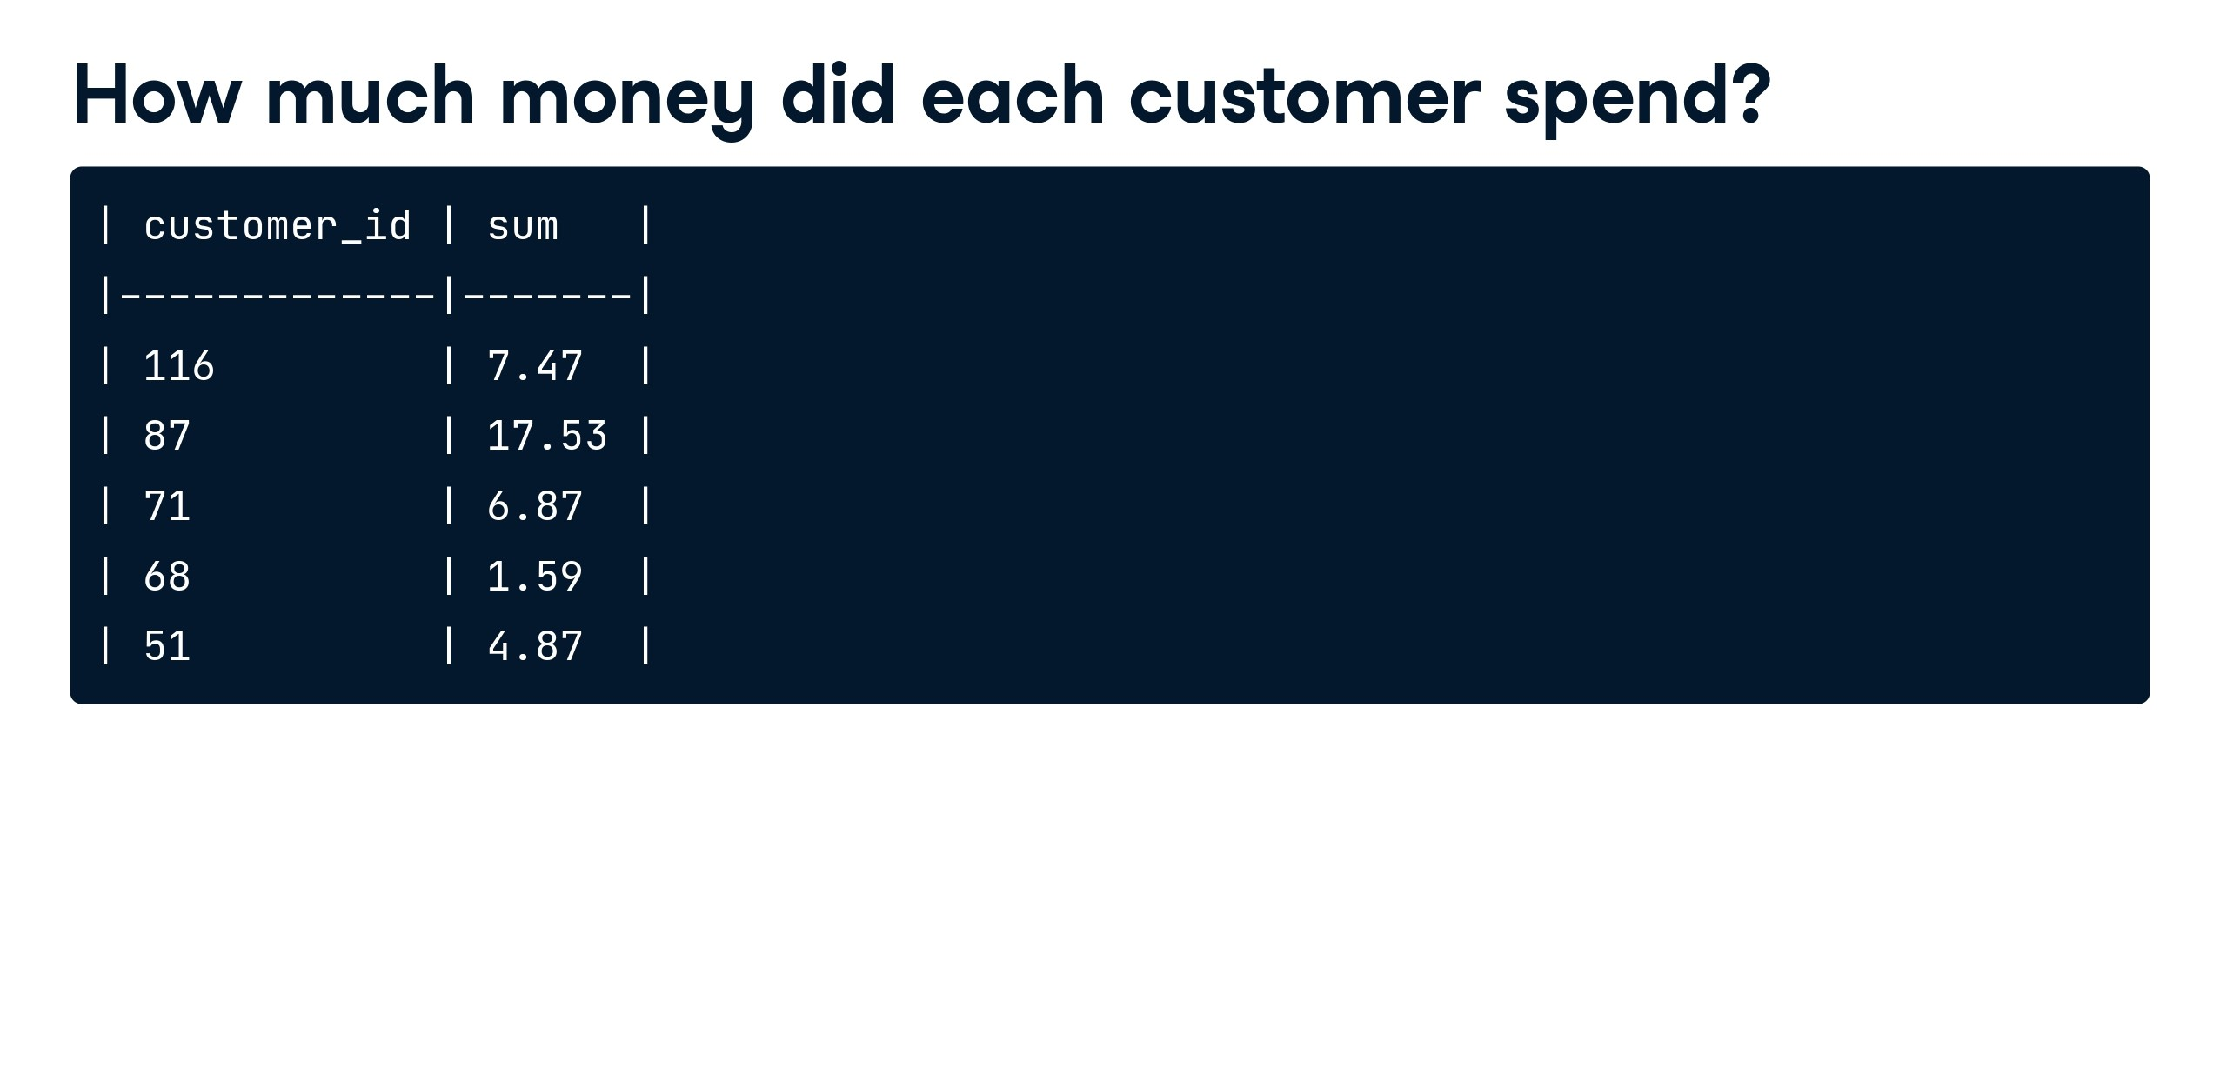

Slide 54


Slide 55
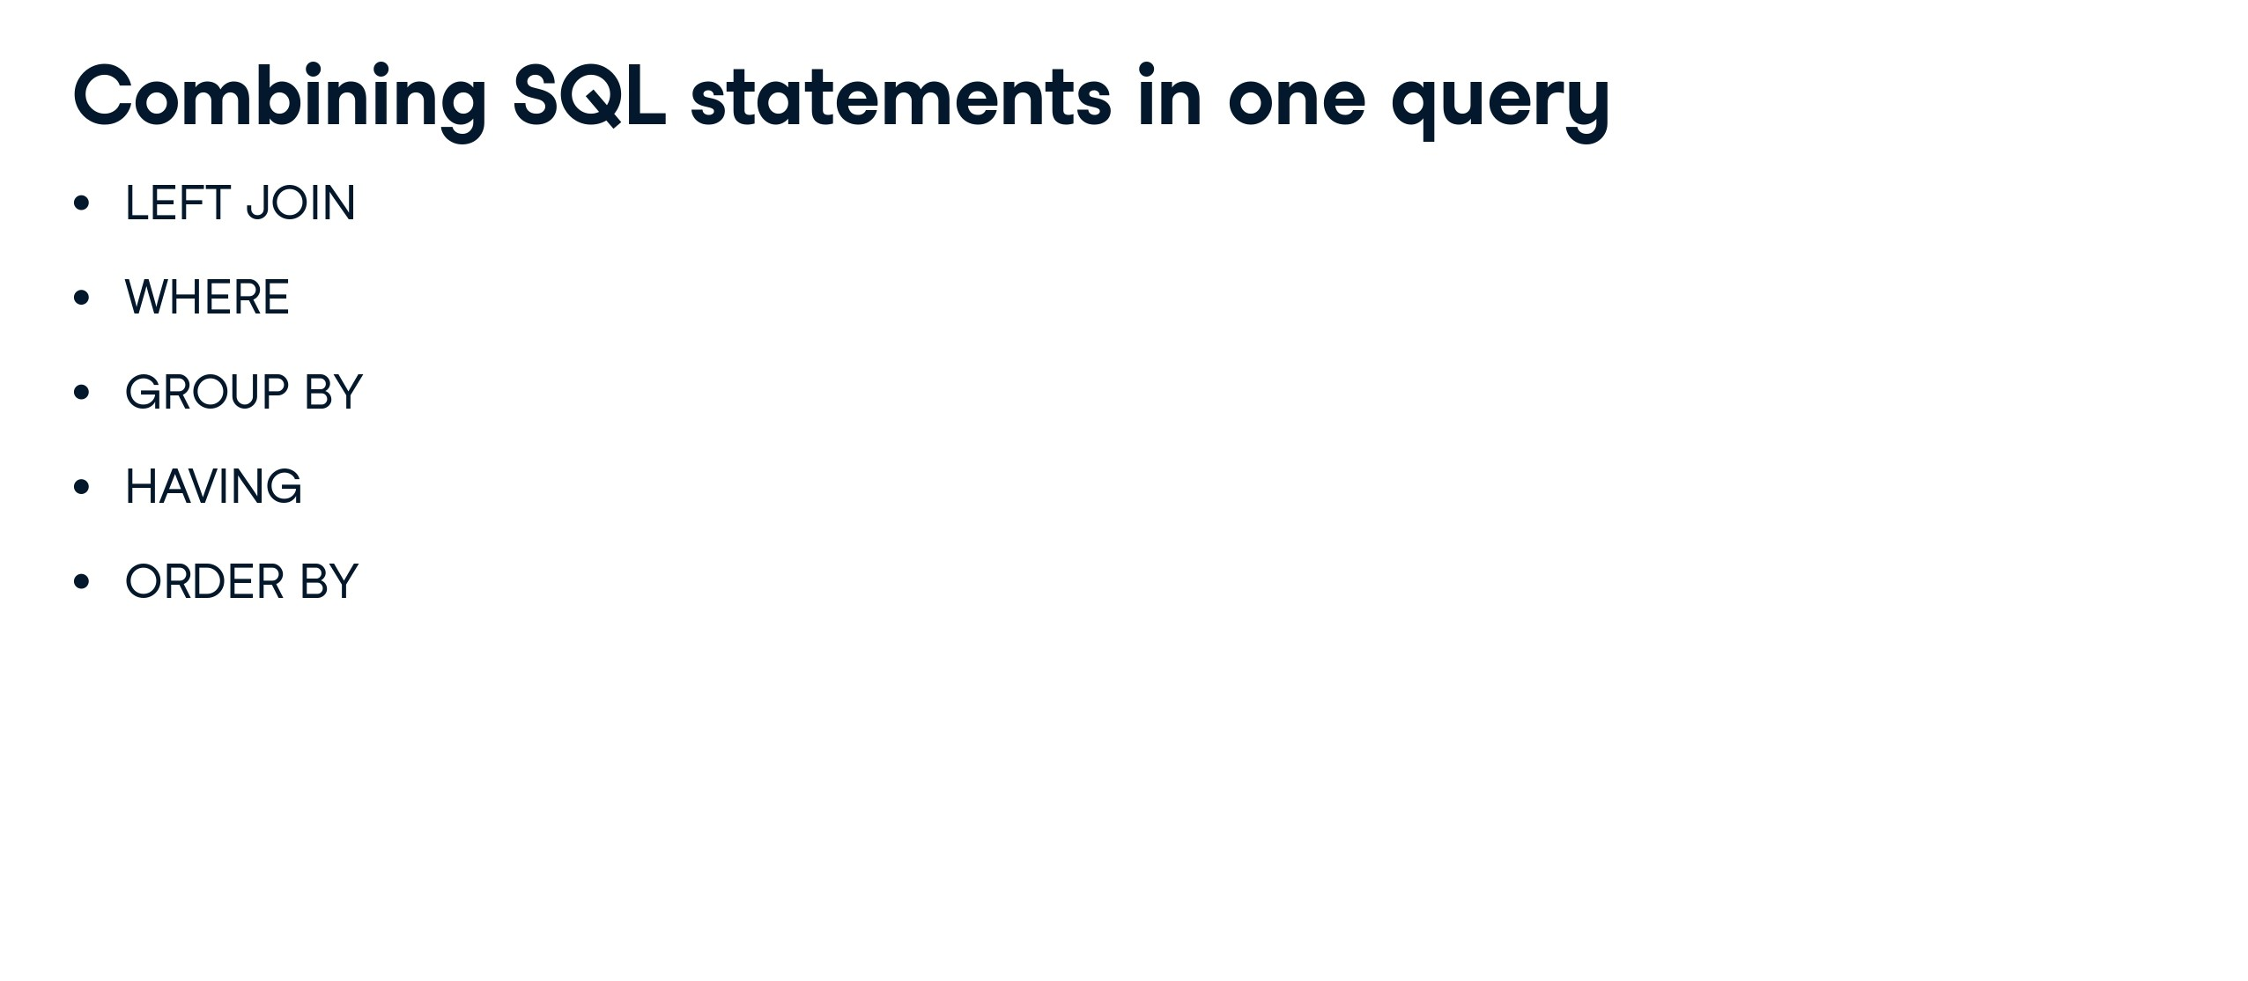

Slide 56
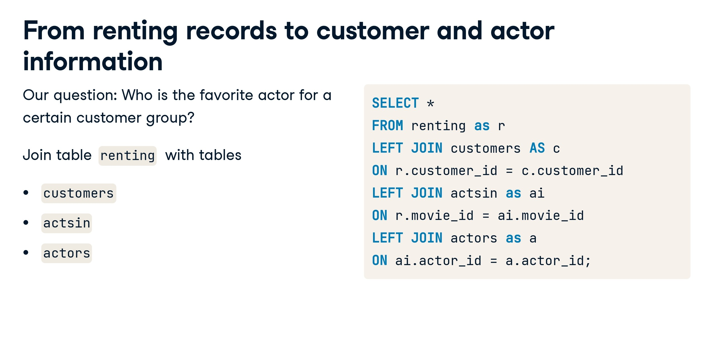

Slide 57
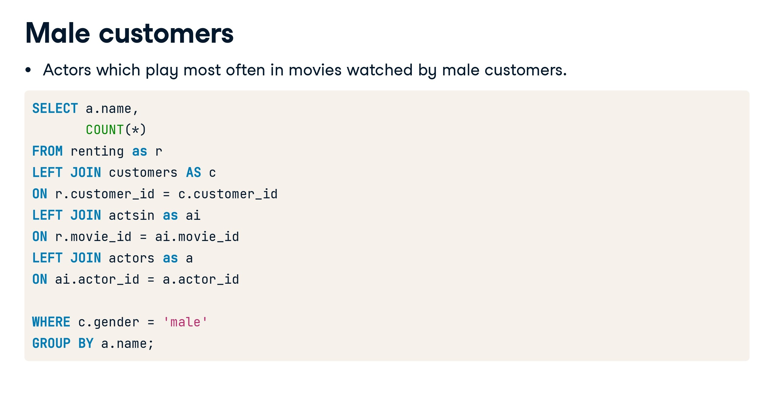

Slide 58
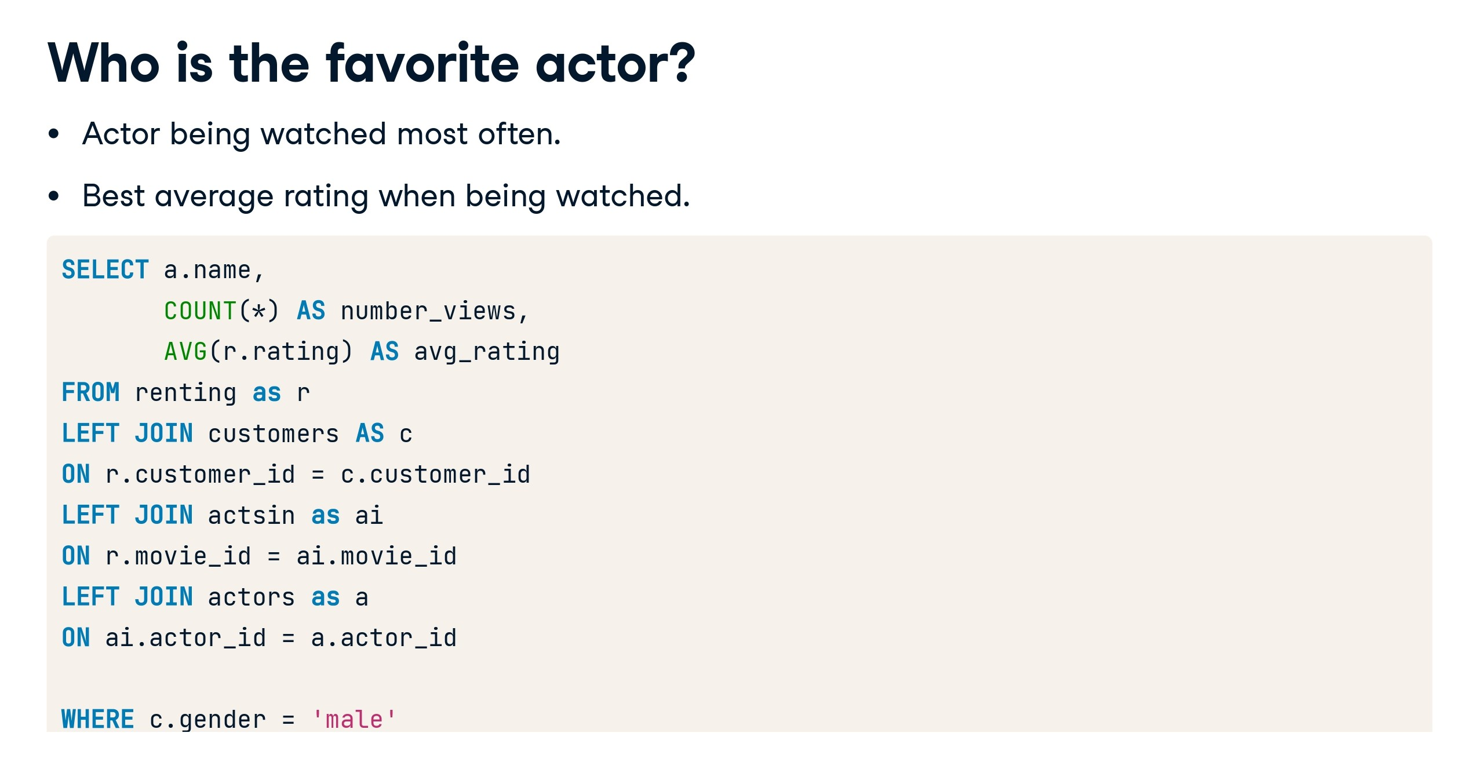

Slide 59
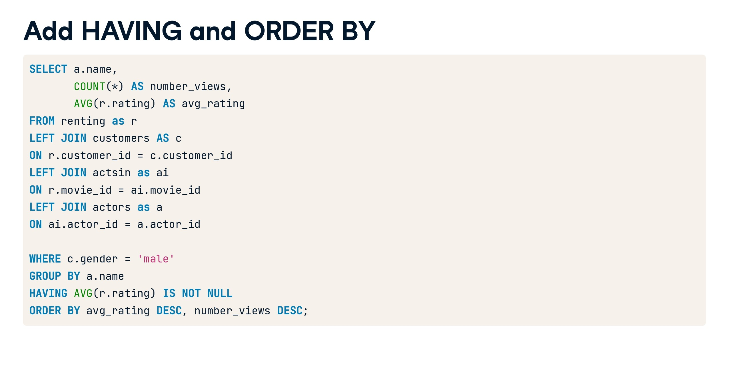

Slide 60
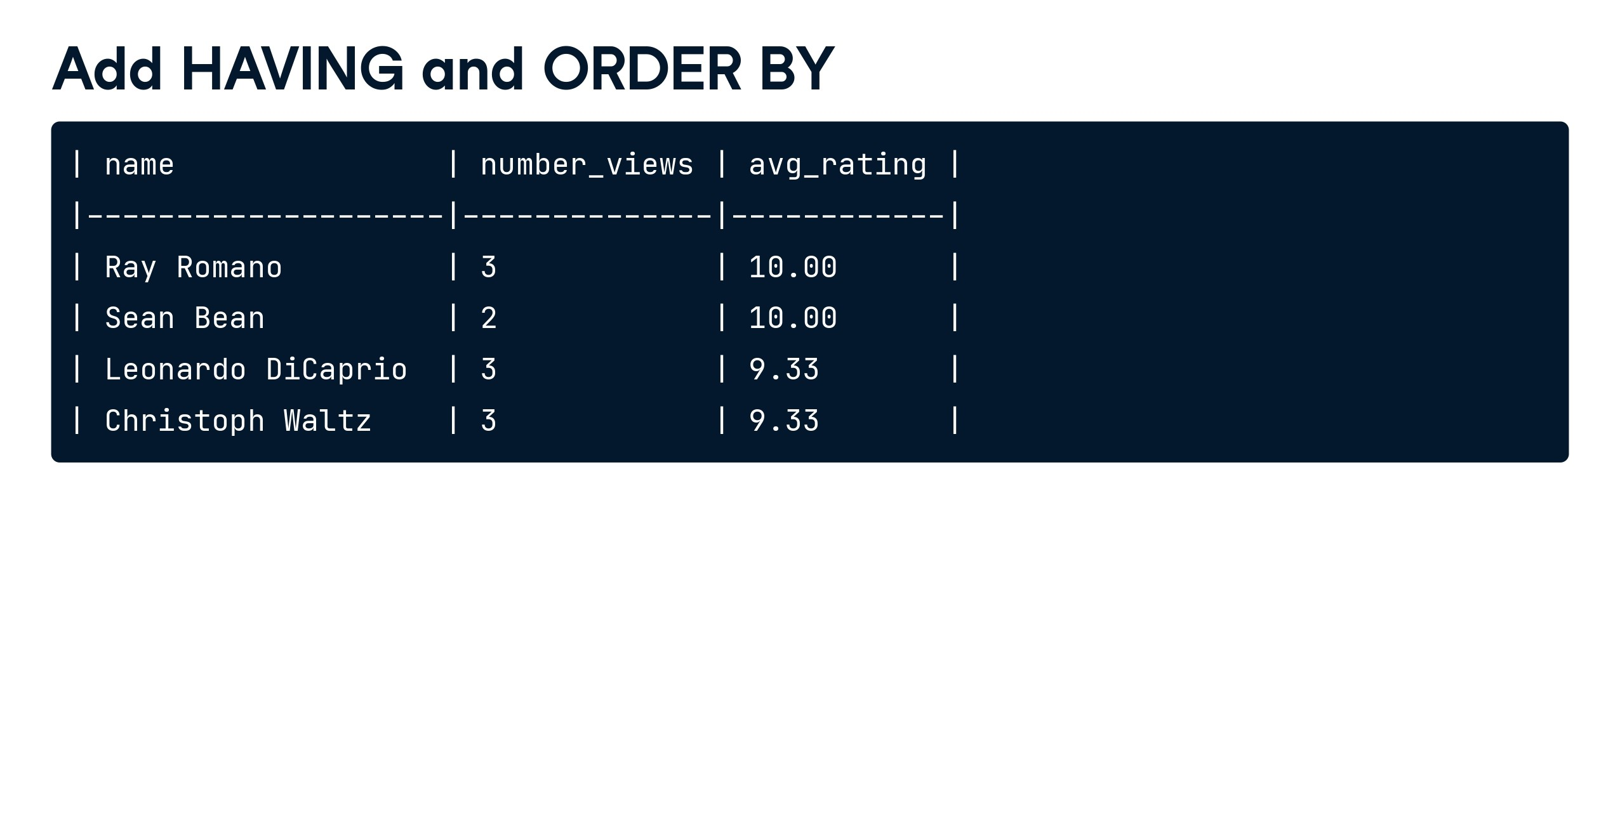

Slide 61


Slide 62
Row number, Rank number, Dense Rank:
-- Create the students table
CREATE TABLE students (
student_id INT PRIMARY KEY,
subject VARCHAR(50),
score INT
);
-- Insert some sample data into the students table
INSERT INTO students ( student_id,subject, score)
VALUES
(1, 'Math', 85),
(2, 'Math', 92),
(3, 'Math', 78),
(4, 'Math', 92),
(5, 'Science', 75),
(6, 'Science', 88),
(7,'Science', 75),
(8,'Science', 92);

Slide 63
Dense Rank:
-- Using DENSE_RANK
SELECT
subject,
score,
DENSE_RANK() OVER (PARTITION BY subject ORDER BY score DESC) AS dense_rank
FROM students1;

Slide 64
Rank:
-- Using RANK
SELECT
subject,
score,
RANK() OVER (PARTITION BY subject ORDER BY score DESC) AS rank
FROM students1;

Slide 65
Row_number:
-- Using ROW_NUMBER
SELECT
subject,
score,
ROW_NUMBER() OVER (PARTITION BY subject ORDER BY score DESC) AS row_number
FROM students1;

Slide 66
Lead:
select emp_id, first_name, salary,
lead(salary) over (order by emp_id) as next_salary
from Employees1

Slide 67
Lag:
select emp_id, first_name, salary,
lag(salary) over (order by emp_id) as next_salary
from Employees1

Slide 68
Rank case over:
Write a SQL query to get the details of employee from each dept whose salary is second highest in that particular department.
Given Data:
We need to create the table
CREATE TABLE Employees ( Emp_id INT PRIMARY KEY, Emp_Name VARCHAR(50), Dept_id INT, Salary DECIMAL(10, 2) );2. We will now insert the data into table
INSERT INTO Employees (Emp_id, Emp_Name, Dept_id, Salary) VALUES (1, 'Sid', 1, 20000); INSERT INTO Employees (Emp_id, Emp_Name, Dept_id, Salary) VALUES (2, 'Jack', 2, 9000); INSERT INTO Employees (Emp_id, Emp_Name, Dept_id, Salary) VALUES (3, 'Eden', 1, 10000); INSERT INTO Employees (Emp_id, Emp_Name, Dept_id, Salary) VALUES (4, 'Evan', 3, 8000); INSERT INTO Employees (Emp_id, Emp_Name, Dept_id, Salary) VALUES (5, 'Adam', 2, 25000); INSERT INTO Employees (Emp_id, Emp_Name, Dept_id, Salary) VALUES (6, 'Kate', 2, 6000); INSERT INTO Employees (Emp_id, Emp_Name, Dept_id, Salary) VALUES (7, 'Leo', 3, 30000); INSERT INTO Employees (Emp_id, Emp_Name, Dept_id, Salary) VALUES (8, 'Zumpa', 1, 3000);

Slide 69
Rank case over:
Write a SQL query to get the details of employee from each dept whose salary is second highest in that particular department.
with cte as (
Select Emp_name , Salary ,
Rank() over (partition by dept_id order by salary desc) as emprank from employees_)
select * from cte where emprank=2;

Slide 70
Case Study #4 - Data Bank
https://8weeksqlchallenge.com/case-study-4/
Solution:
https://github.com/ndleah/8-Week-SQL-Challenge/blob/main/Case%20Study%20%234%20-%20Data%20Bank/README.md#dataset

Slide 71
Function returning value/rows in SQL
select * from Employees
-- scaler function
create function add_five_value(@num as int)
returns int
as
begin
return @num+5
end
select dbo.add_five_value(15) as function_output

Slide 72
Function returning table in SQL
select * from Employees
-- scaler function
create function add_five_table(@first_n varchar(20))
returns table
as
return
select * from Employees where first_name=@first_n
select * from dbo.add_five_table('Sachin')

Slide 73
Function for custom mathmatical opertaion in SQL
create function sachin3(@num1 int,@num2 int)
returns int
as
begin
declare @result int
set @result =@num1+@num2
return @result
end
select dbo.sachin3(15,35)

Slide 74
Trigger Introduction in SQL
CREATE TRIGGER trigAddStudentsKumar
ON [bhagwat].[dbo].[Employees]
FOR INSERT
AS
DECLARE @Newname VARCHAR(100)
SELECT @Newname =(SELECT department FROM INSERTED)
PRINT 'THE STUDENT New ' + @Newname + ' IS ADDED.';
INSERT INTO [bhagwat].[dbo].[Employees]([emp_id],[department]) VALUES (871,'George Mathew');

